Slide 1
Hands-on NodeJS + JavaScript + Debug(WebStorm) + TypeScript
arnaud.nauwynck@gmail.com
Esilv 2023
This document: https://github.com/Arnaud-Nauwynck/presentations/tree/main/web/tp1-nodejs.pdf

Slide 2
Objectives
Discover NodeJs using practical « Hello World » developper code
Using Simple baby steps, step by step
Setup your web environment
Become familiar with the Web FrontEnd ecosystem

Slide 3
Outline
Download + Install NodeJs
Run NodeJS from the command line
Discover and run basic javascript program
Discover NPM Node Package Manager
Install package.json dependencies
Install WebStorm IDE (students may choose any IDE, VisualStudio Code)
Debug Javascript program
TypeScript to JavaScript from the IDE
Tsc compiler
Debug TypeScript

Slide 4
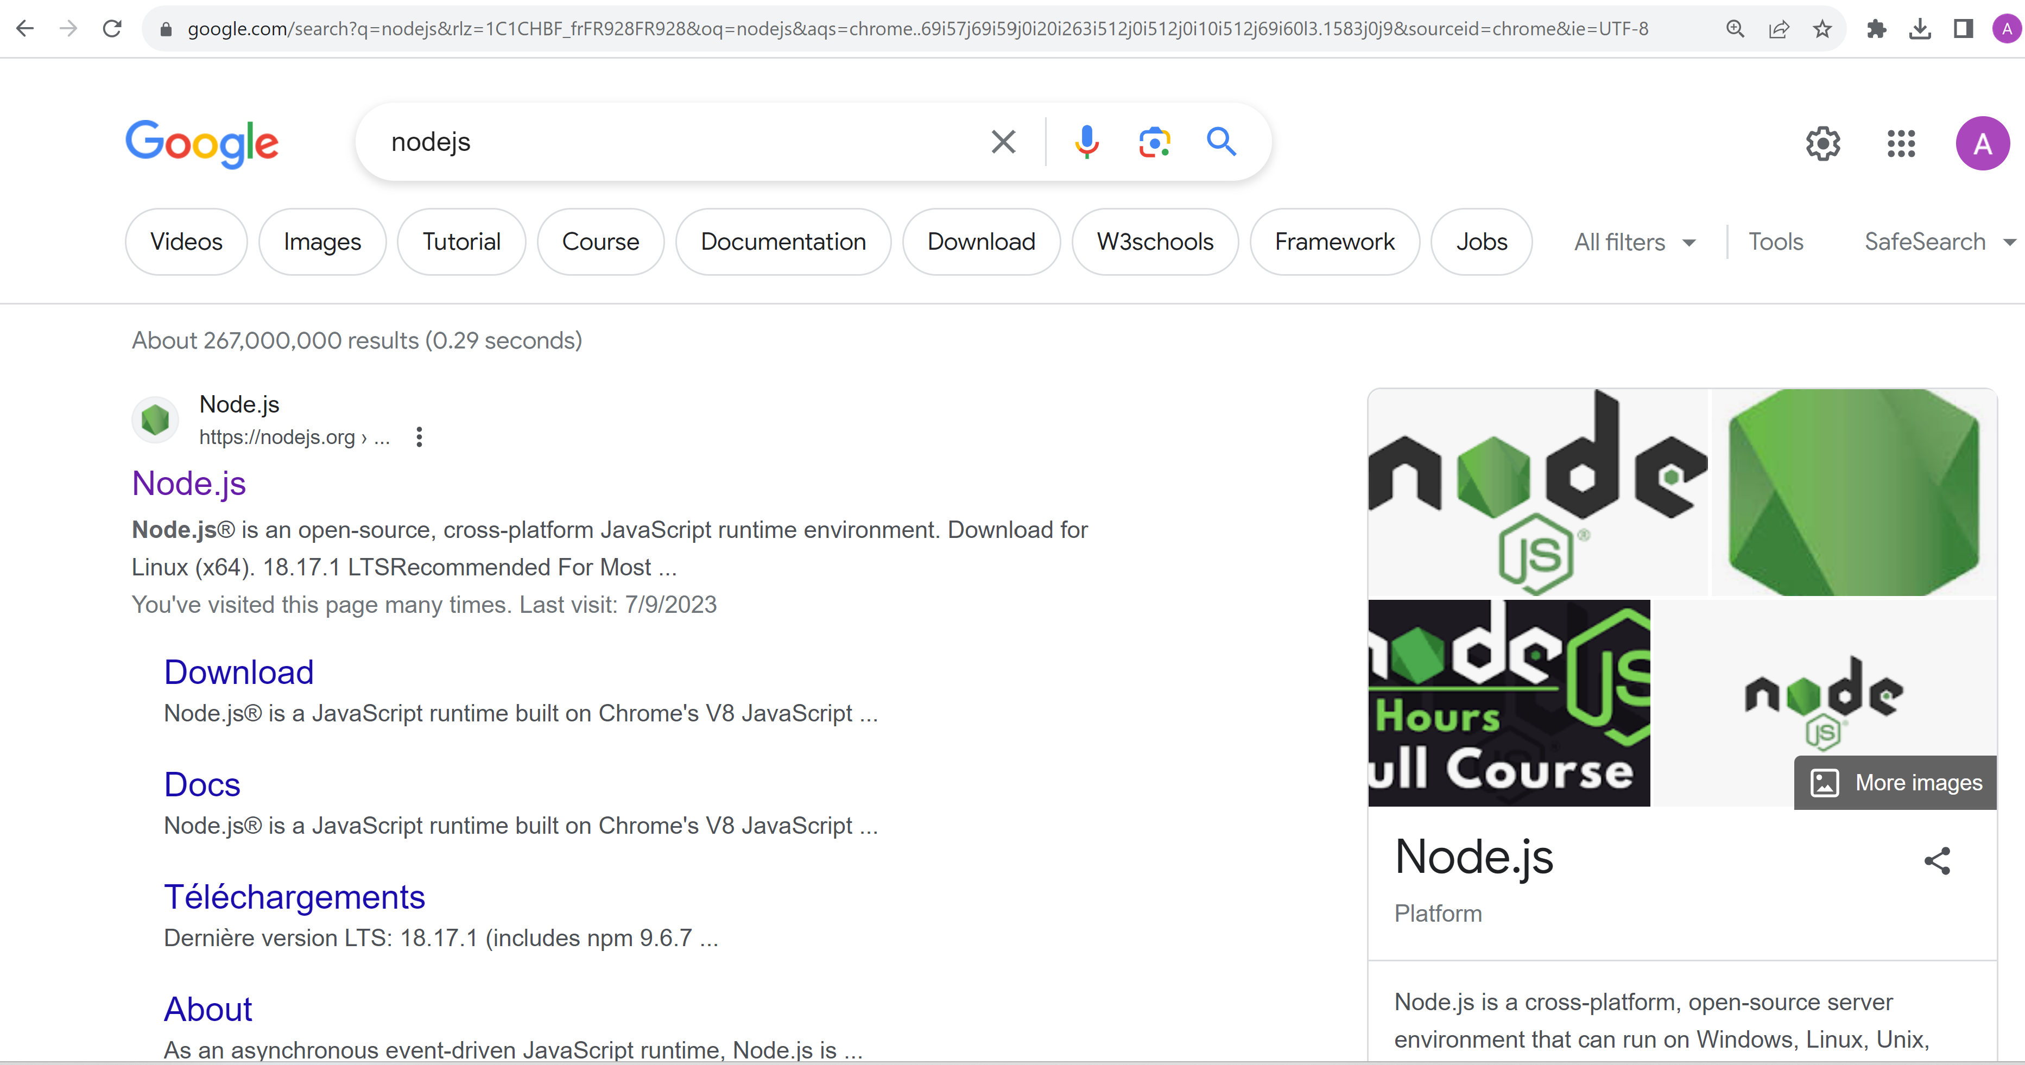
Google NodeJs

Slide 5
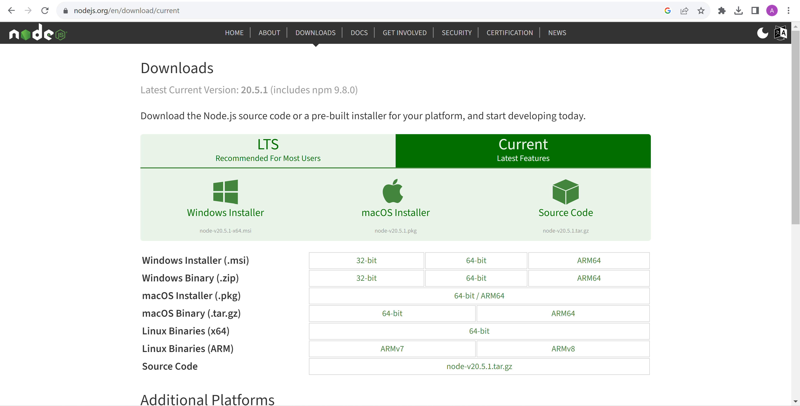
Download NodeJs

Slide 6
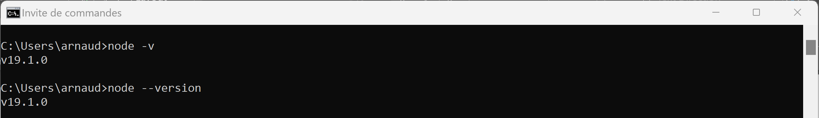
Check NodeJs exe (check version) C:> node -v

Slide 7
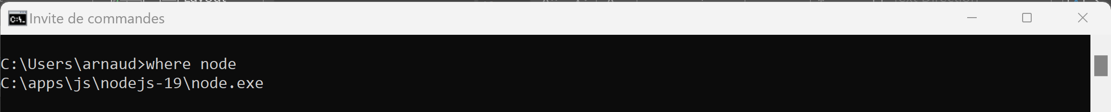
Several installed ? … which one will be resolved C:> where node
System Diagnostic

Slide 8
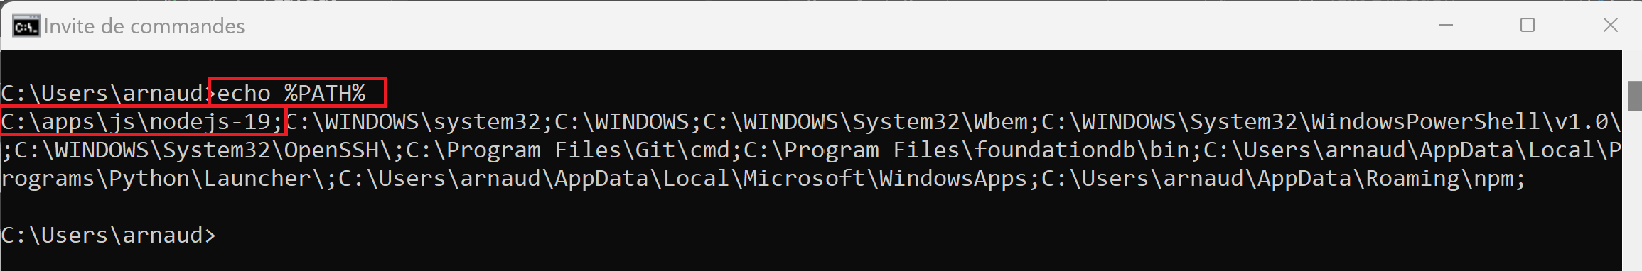
Check NodeJS is in « %PATH% »(win cmd terminal) echo %PATH%
System Diagnostic

Slide 9
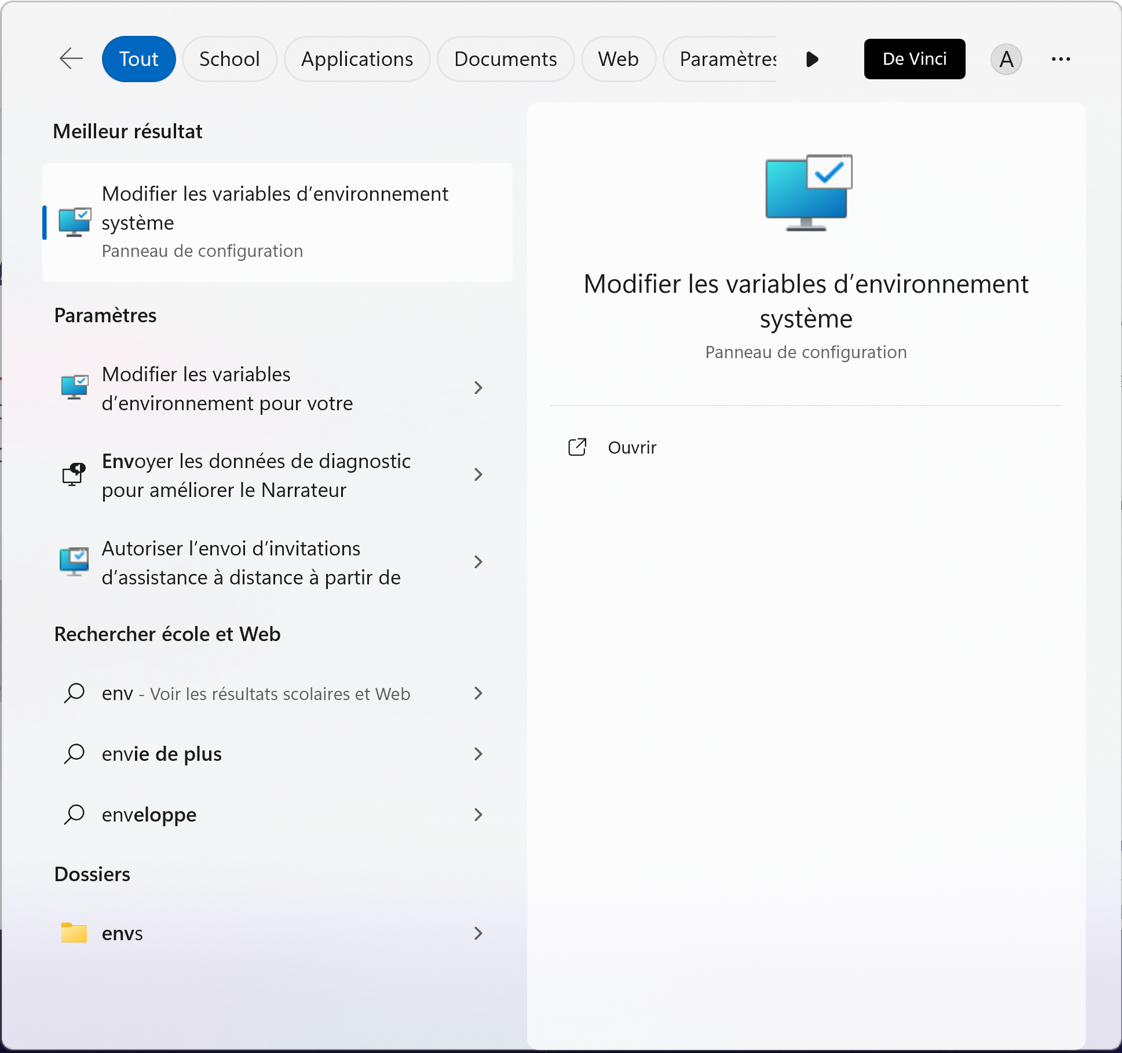
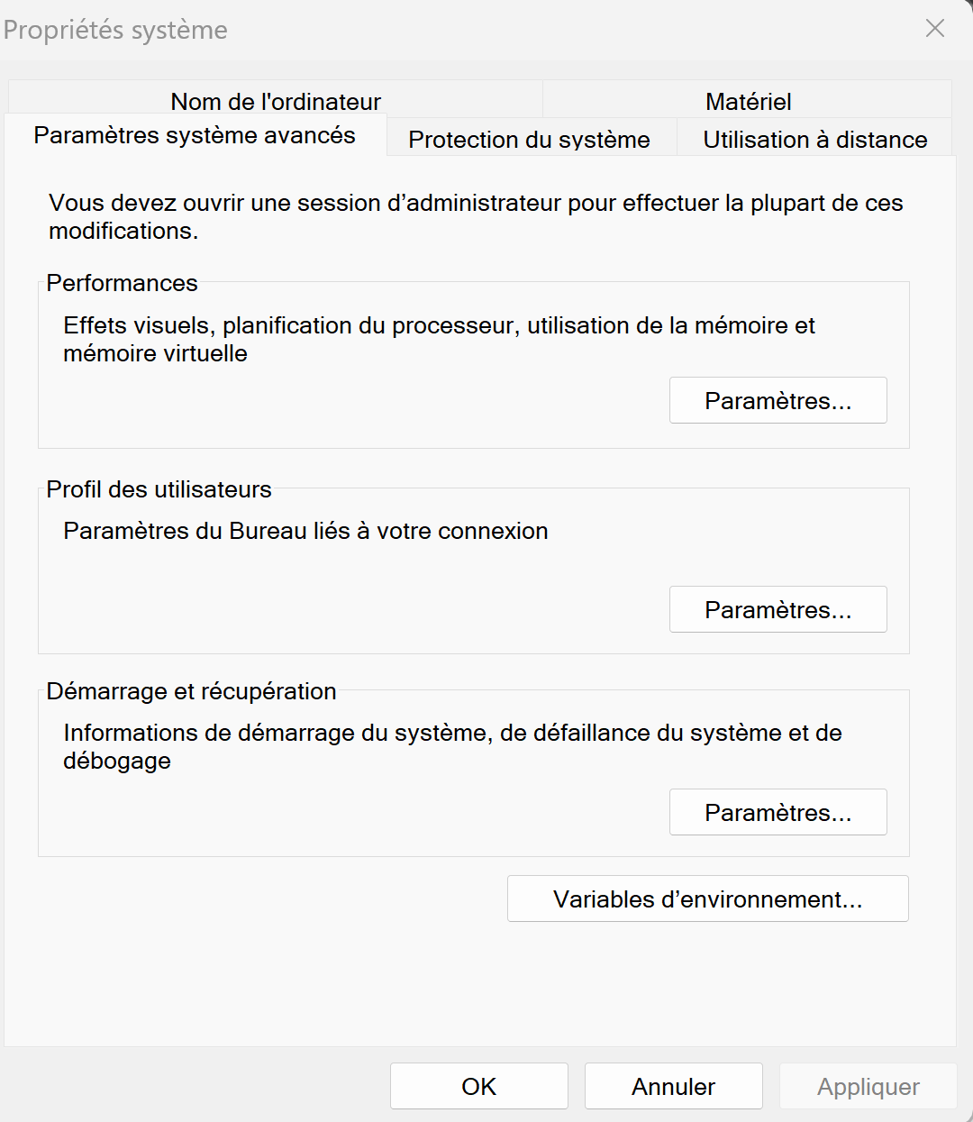
Edit System or User Environment Variables
System Diagnostic

Slide 10
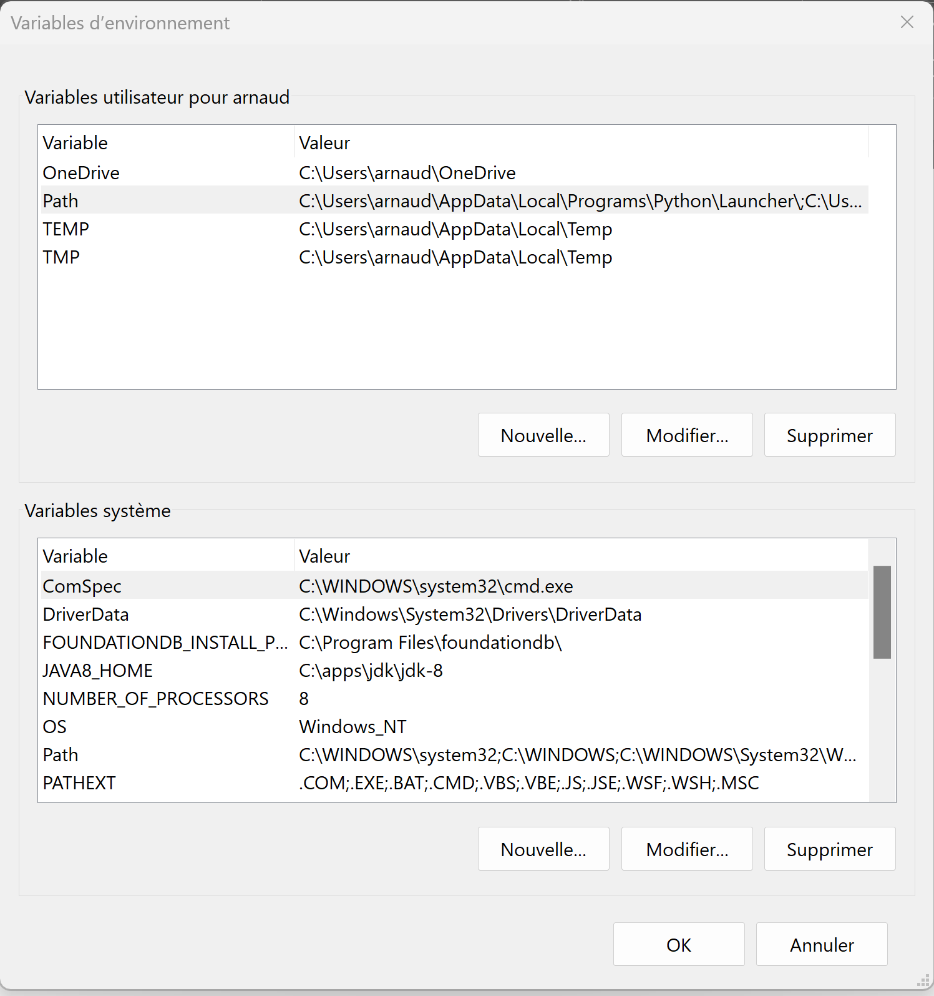
Edit {user|system} PATH environment variable
System Diagnostic

Slide 11
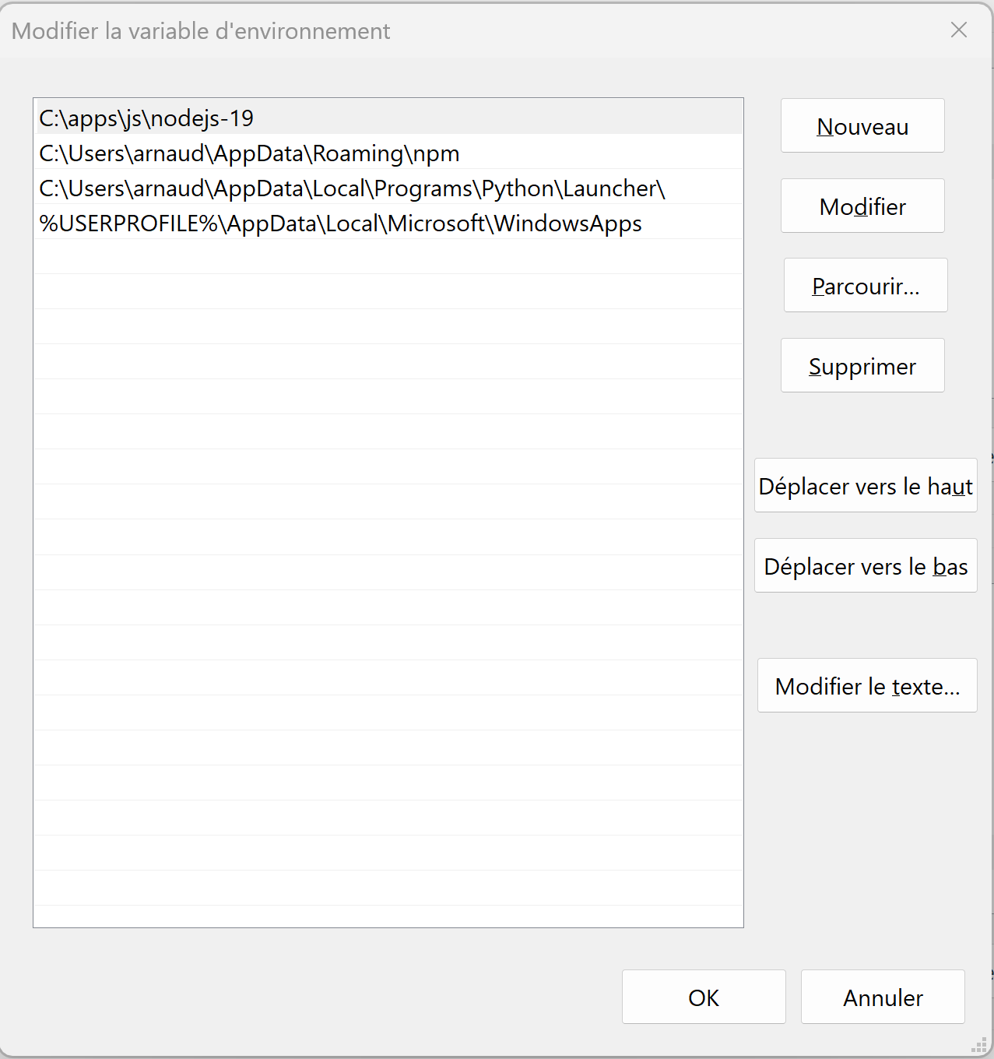
Prepend(=max priority) or Append to PATH
System Diagnostic
Then restart
your terminals & apps !!
( env vars are inherited during program starts )

Slide 12
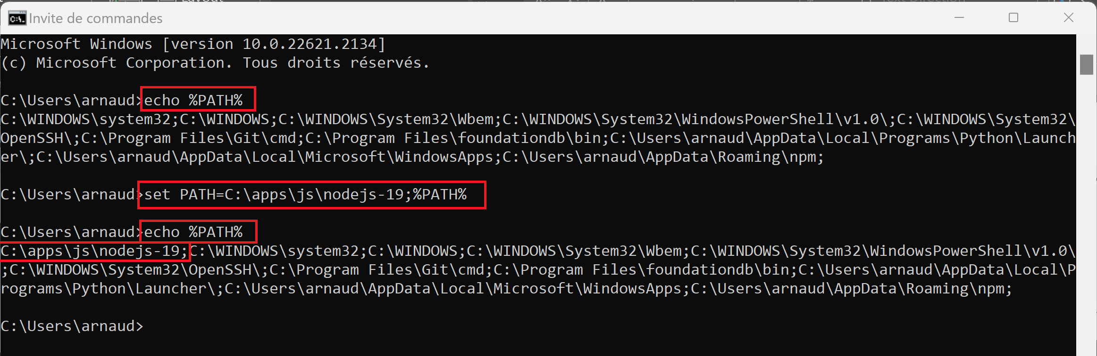
Override in terminal to add in « %PATH% » ( may edit + call setenv.cmd) set PATH=c:\your-node-dir;%PATH%
System Diagnostic

Slide 13
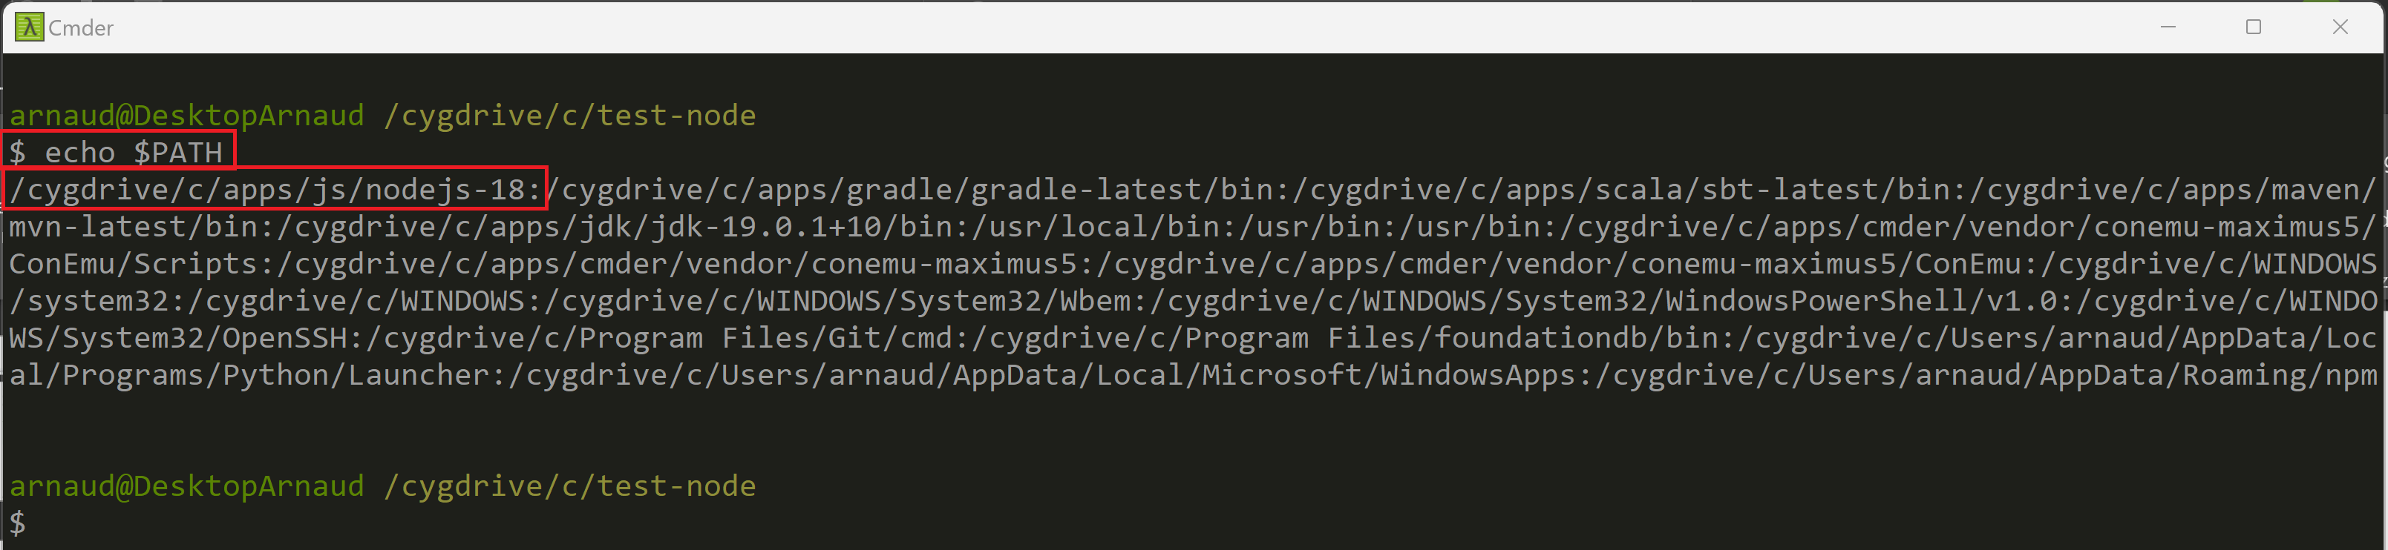
Case 2… using Cmder > Bash$ Check NodeJS « $PATH » echo $PATH
System Diagnostic

Slide 14
Case 2 … using Cmder Bash, Adding in $PATH ( may edit in your $HOME/.profile or .bashrc ) export PATH=/c/your-node-dir:$PATH
System Diagnostic

Slide 15
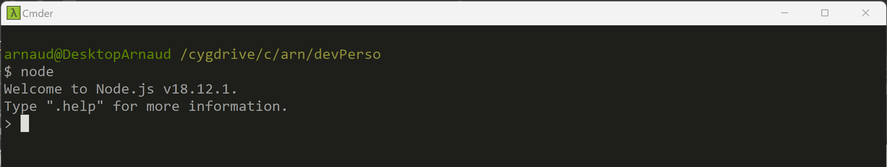
Start NodeJs interactive prompt C:> node

Slide 16
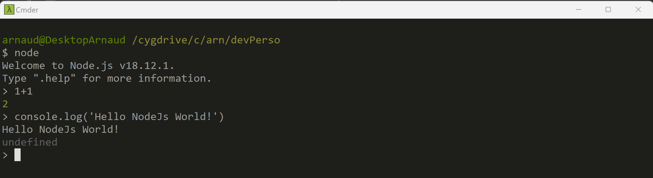
Play with interactive Javascript eval 1+1 console.log(‘Hello’)

Slide 17
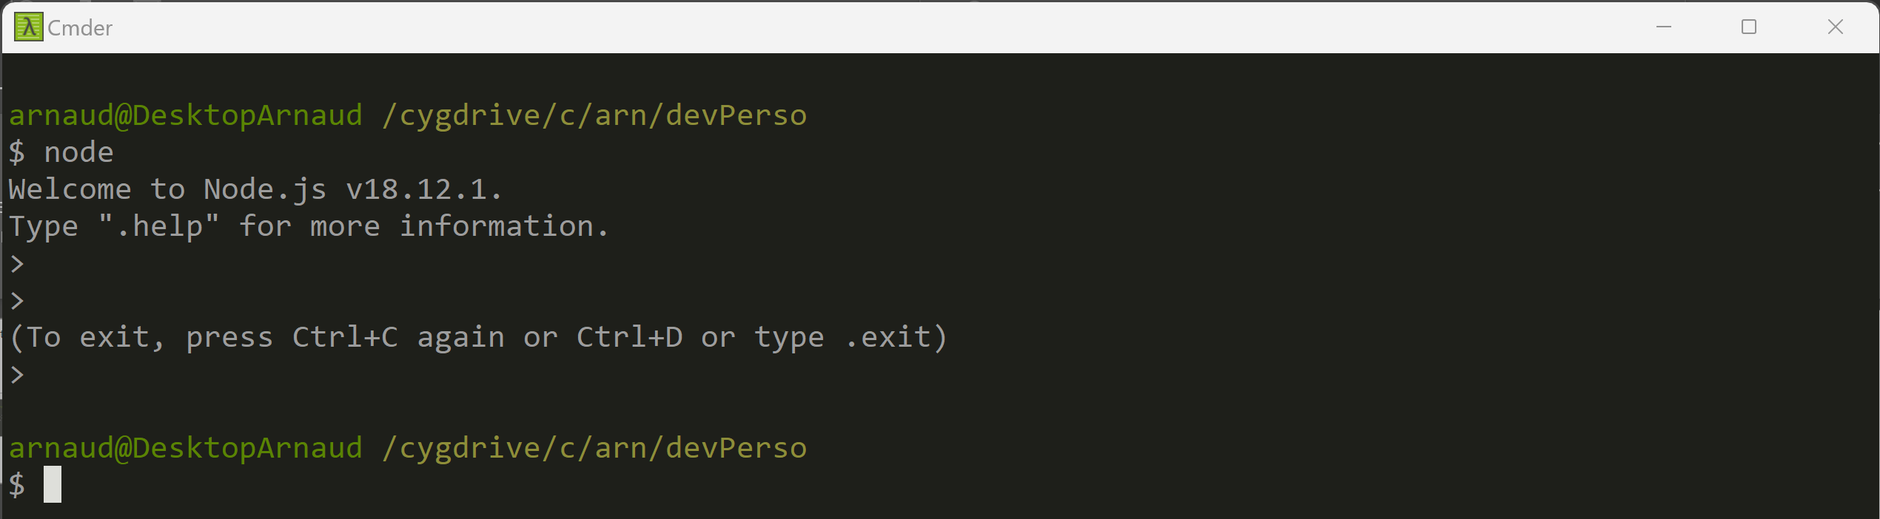
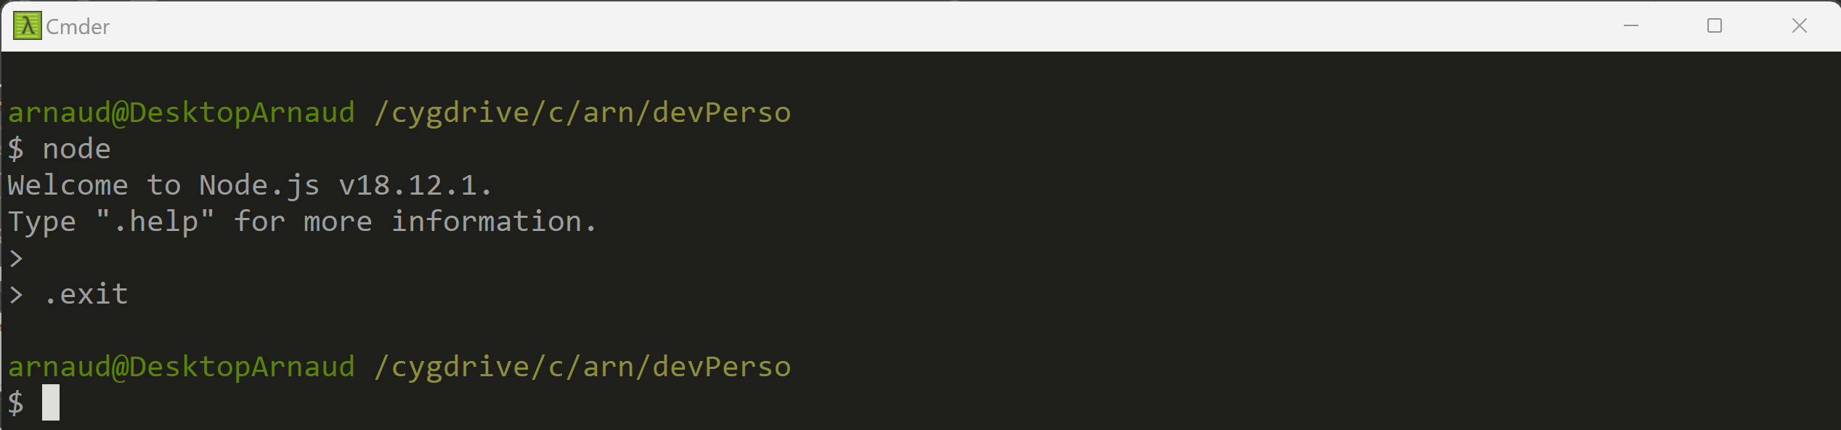
Stop Prompt … Ctrl+C Ctrl+C or .exit

Slide 18
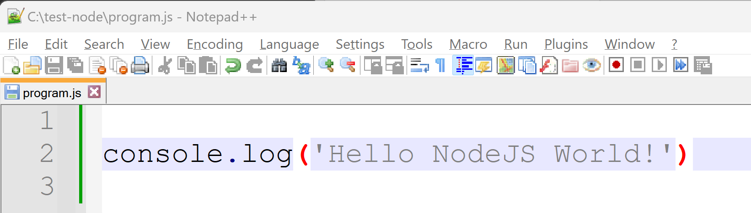
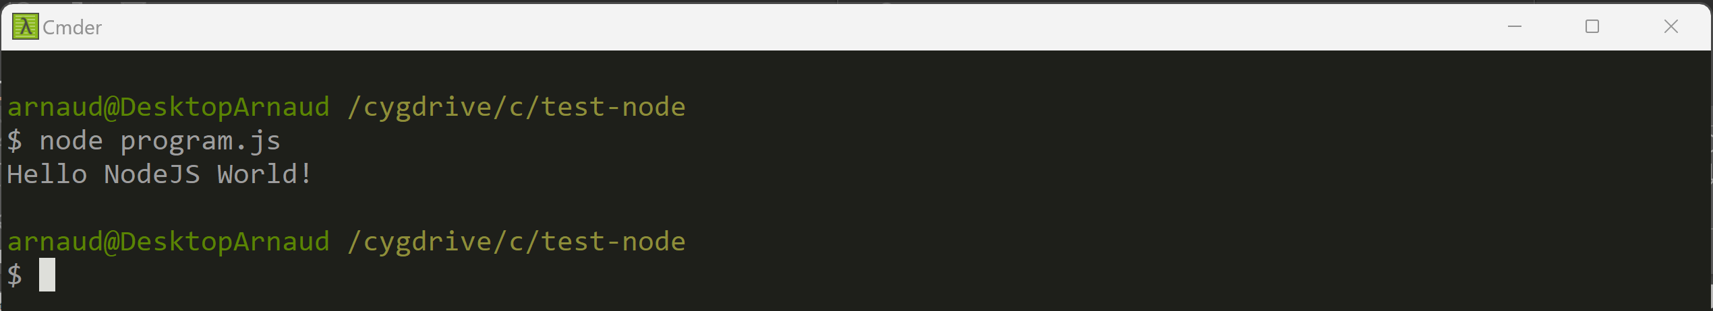
Start NodeJs on a « program.js » file C:> node program.js

Slide 19
Coffee Break (?)

Slide 20
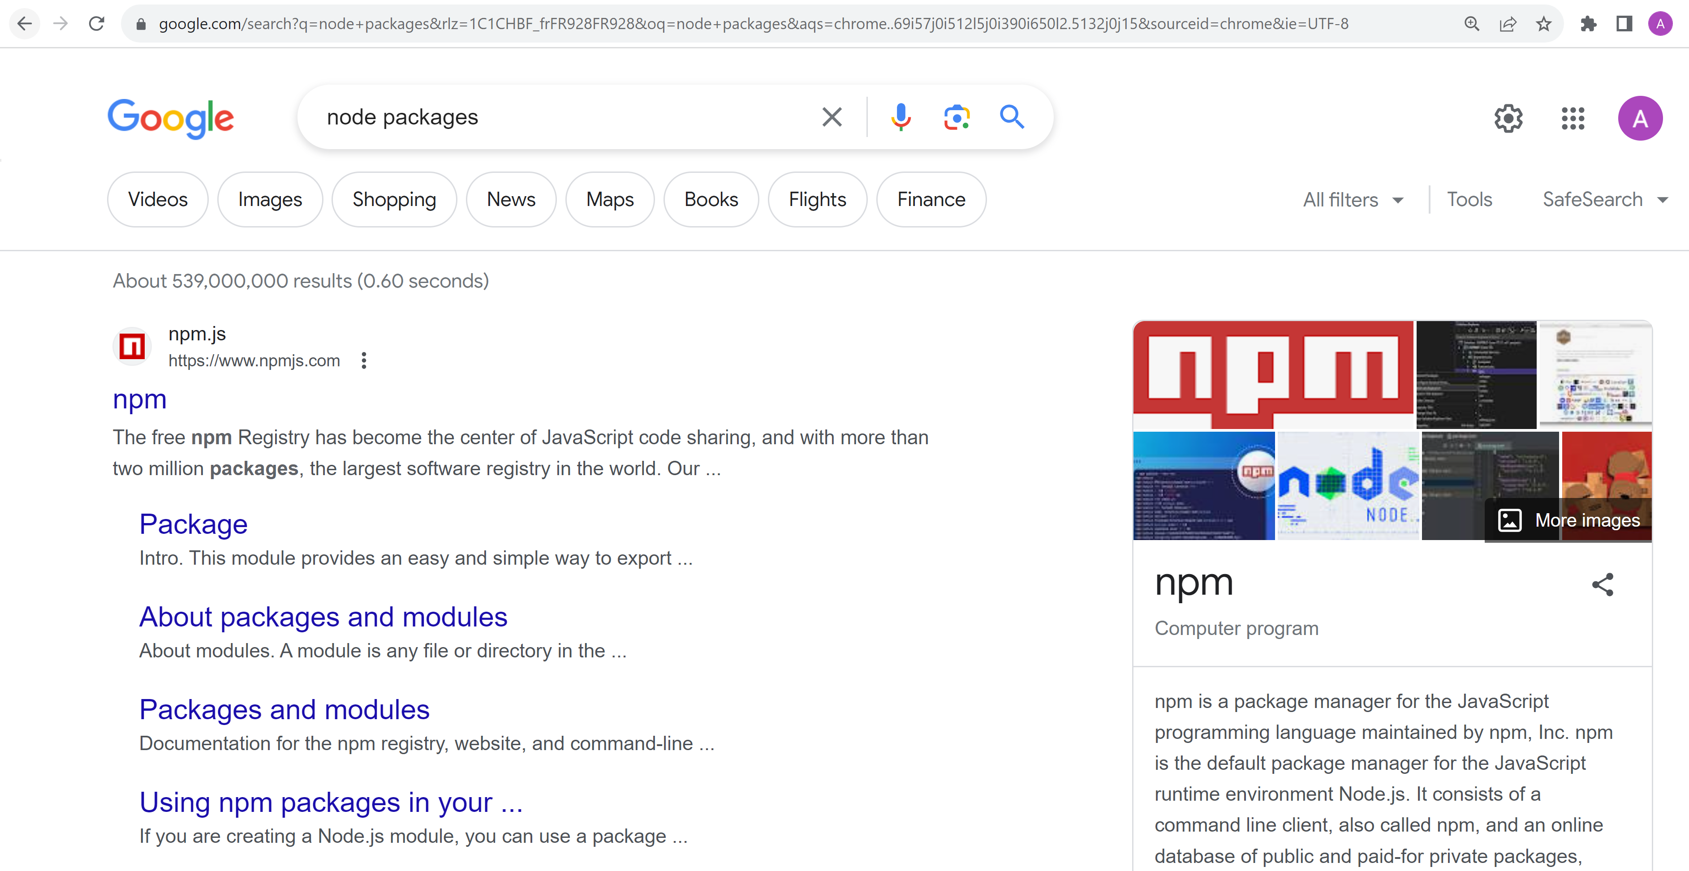
Node … need Package !!! Npm = Node Package Manager

Slide 21
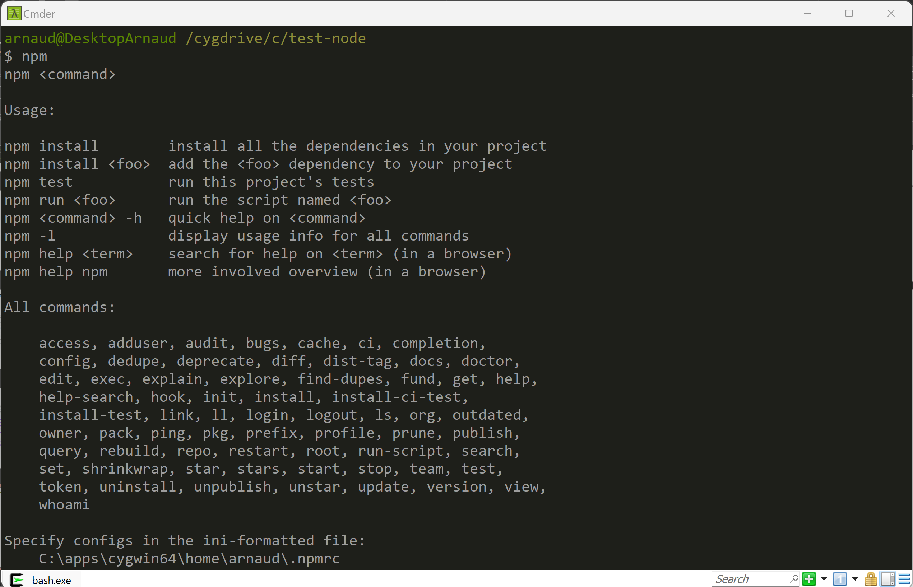
C:> npm

Slide 22
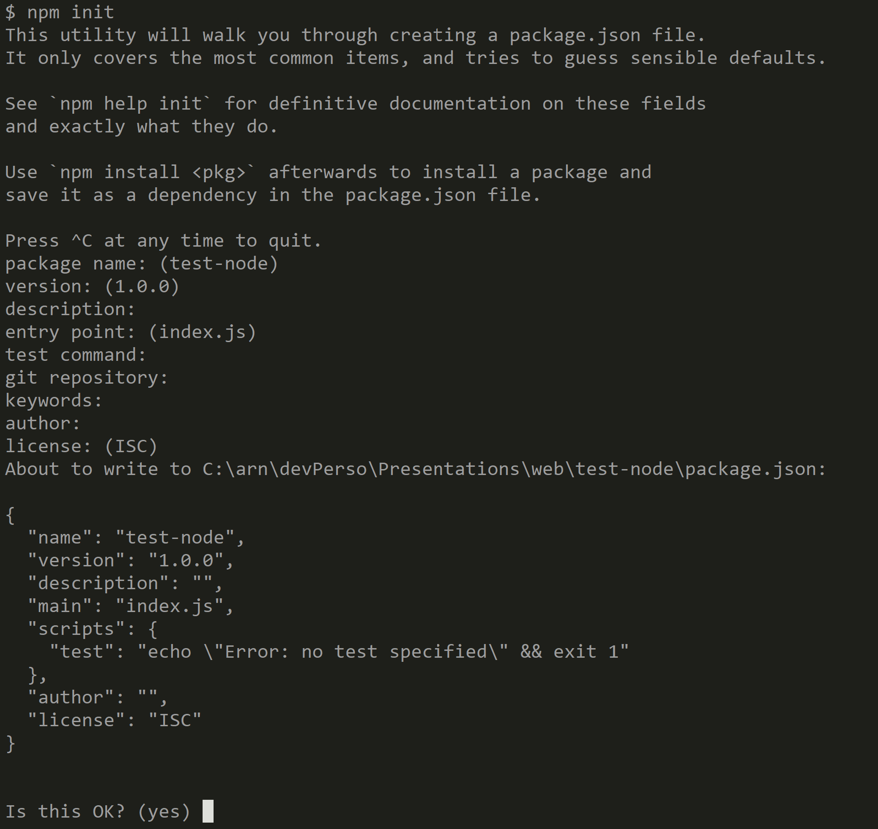
$ npm init

Slide 23
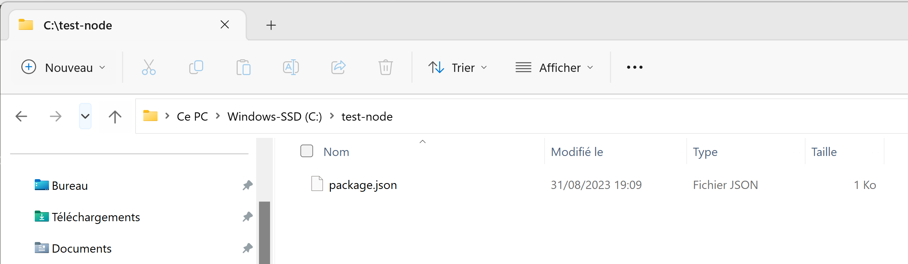
npm init => open File explorer => 1 File « package.json »

Slide 24
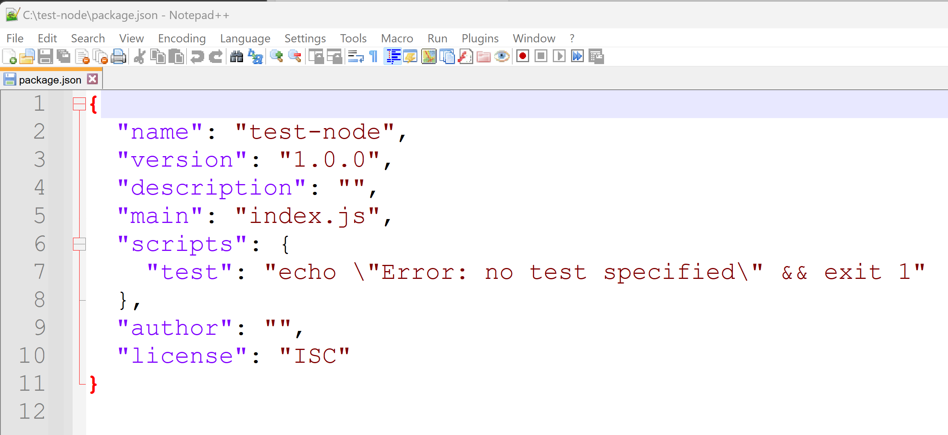
package.json

Slide 25
Search Package dependencies ? ...

Slide 26
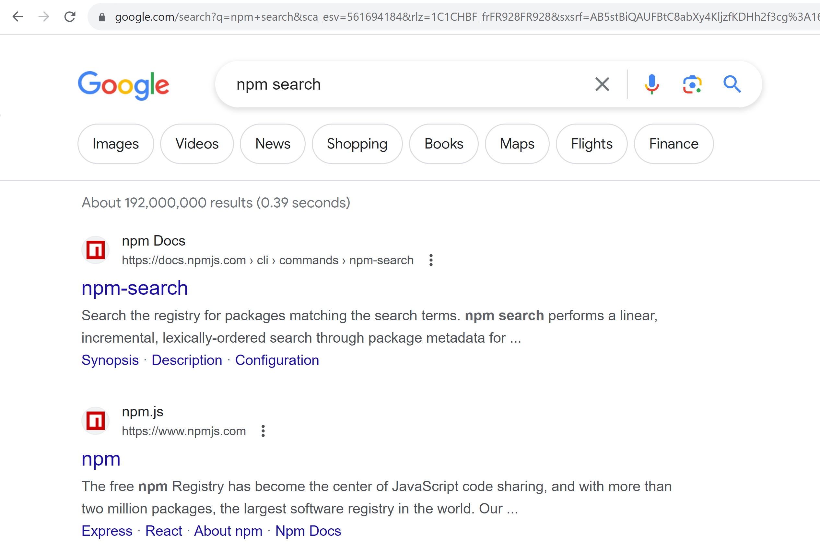
Npm search … Registry (=Repository)

Slide 27
https://npmjs.com

Slide 28
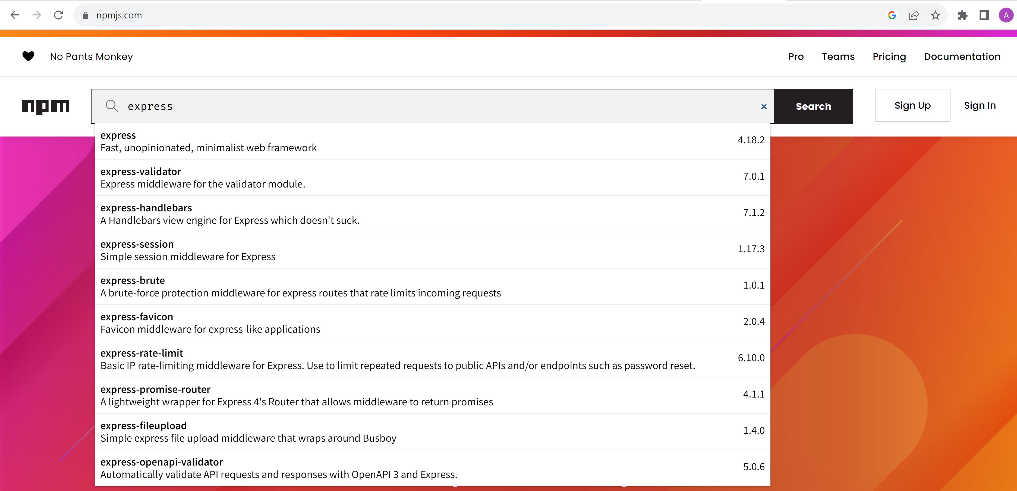
Search « express » package

Slide 29
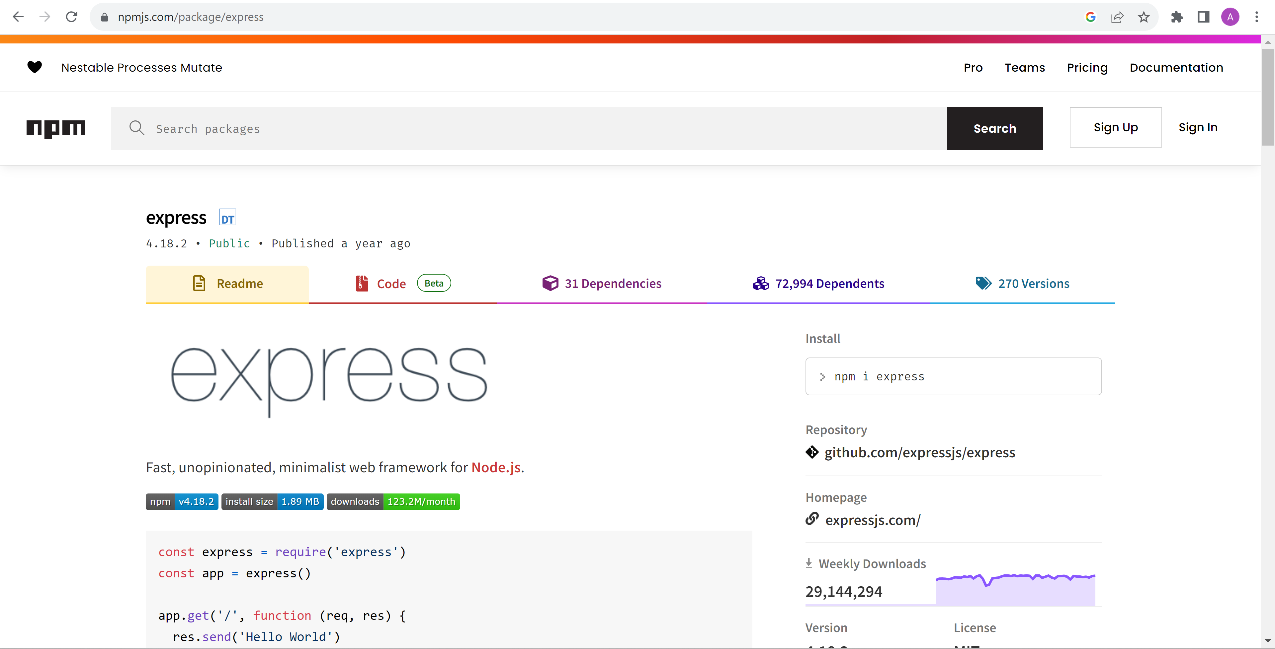
Package express … version / doc / install

Slide 30
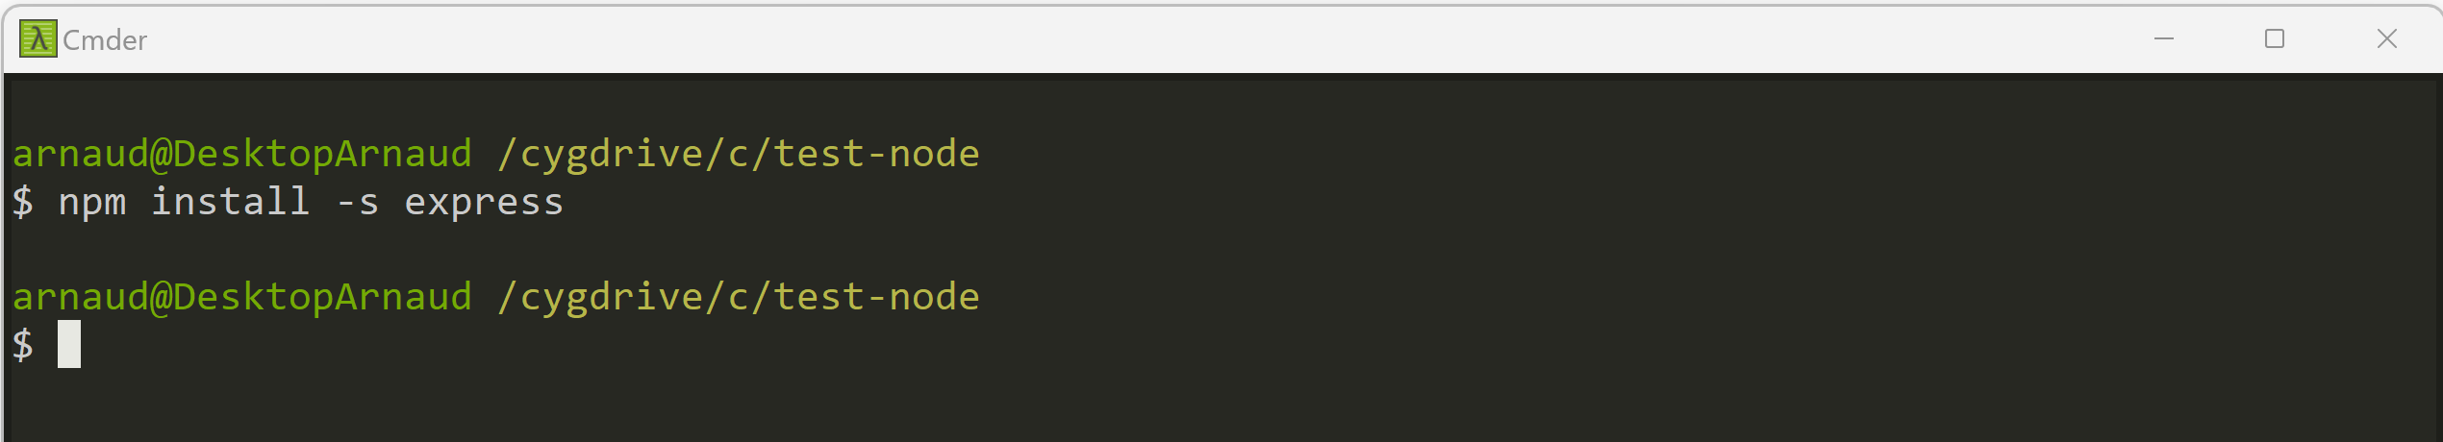
Add npm dependency « express » C:> npm install –s express (equivalent: npm install --save express )

Slide 31
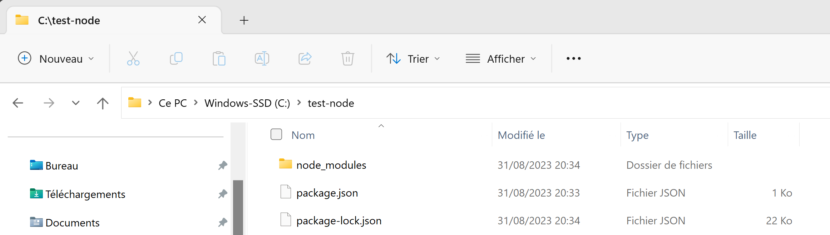
npm --save …. => save to package.json file + package-lock.json + download **/** to node_modules/

Slide 32
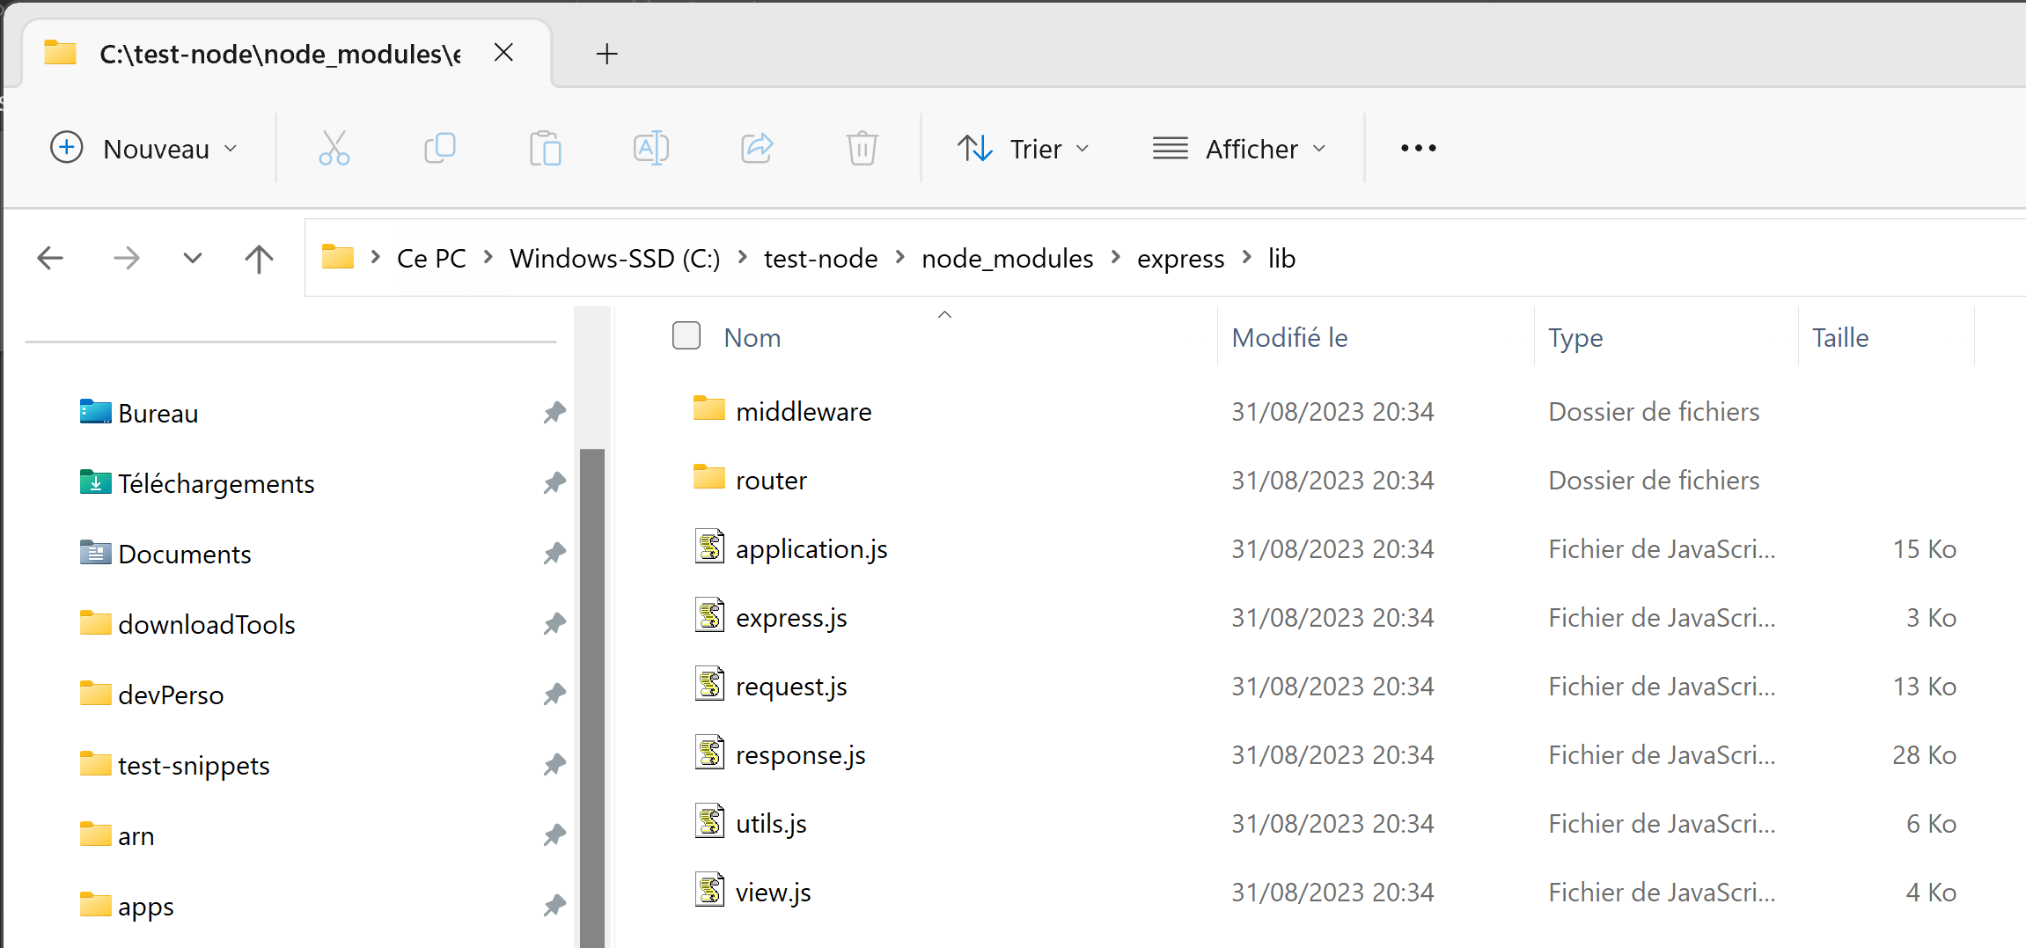
node_modules/express/lib/**/*.js

Slide 33
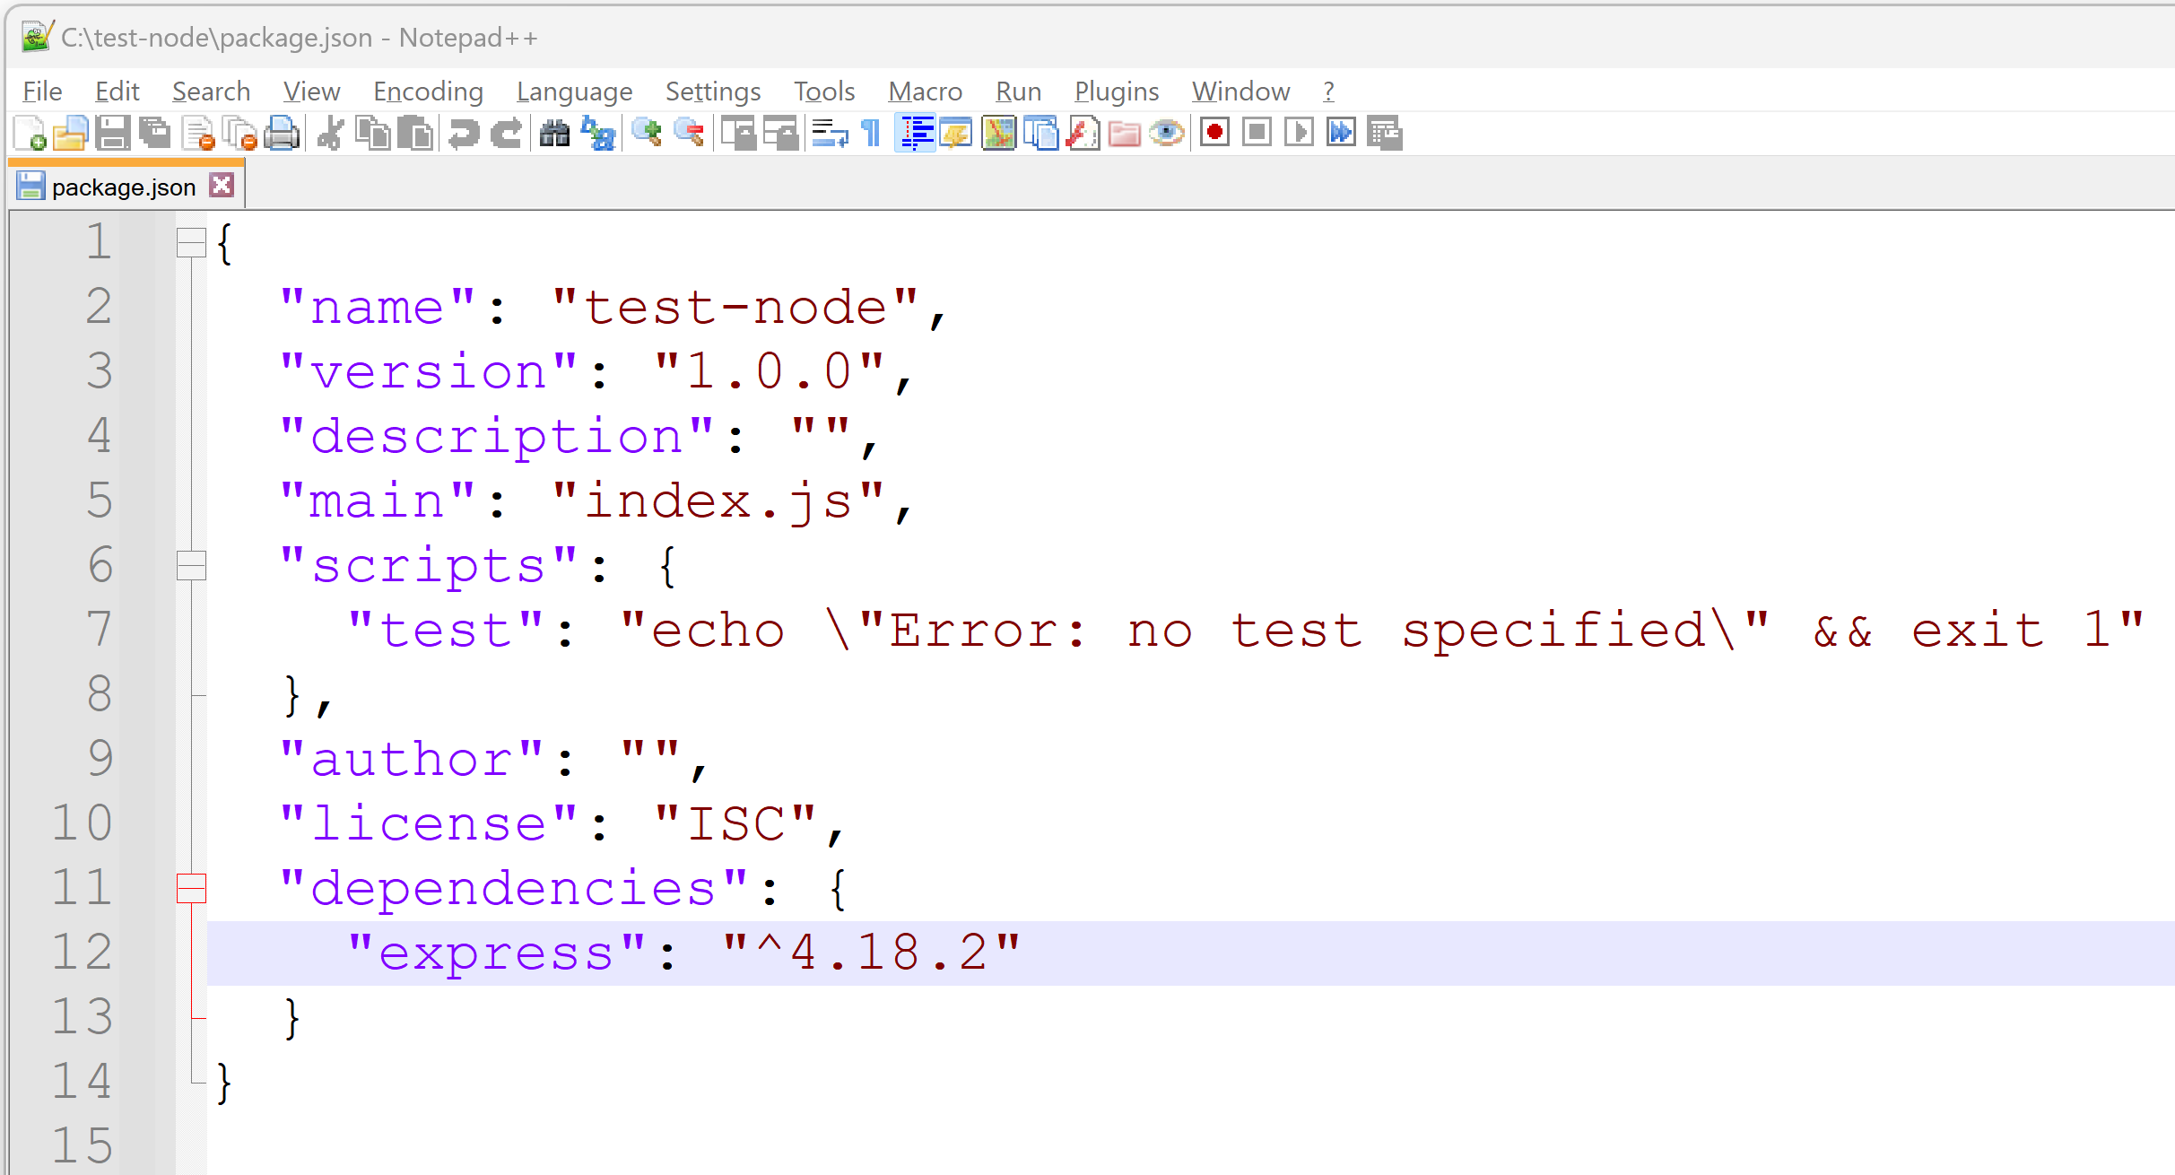
… 1 Line added in package.json dependencies: { «pck-name» : « version », … }

Slide 34
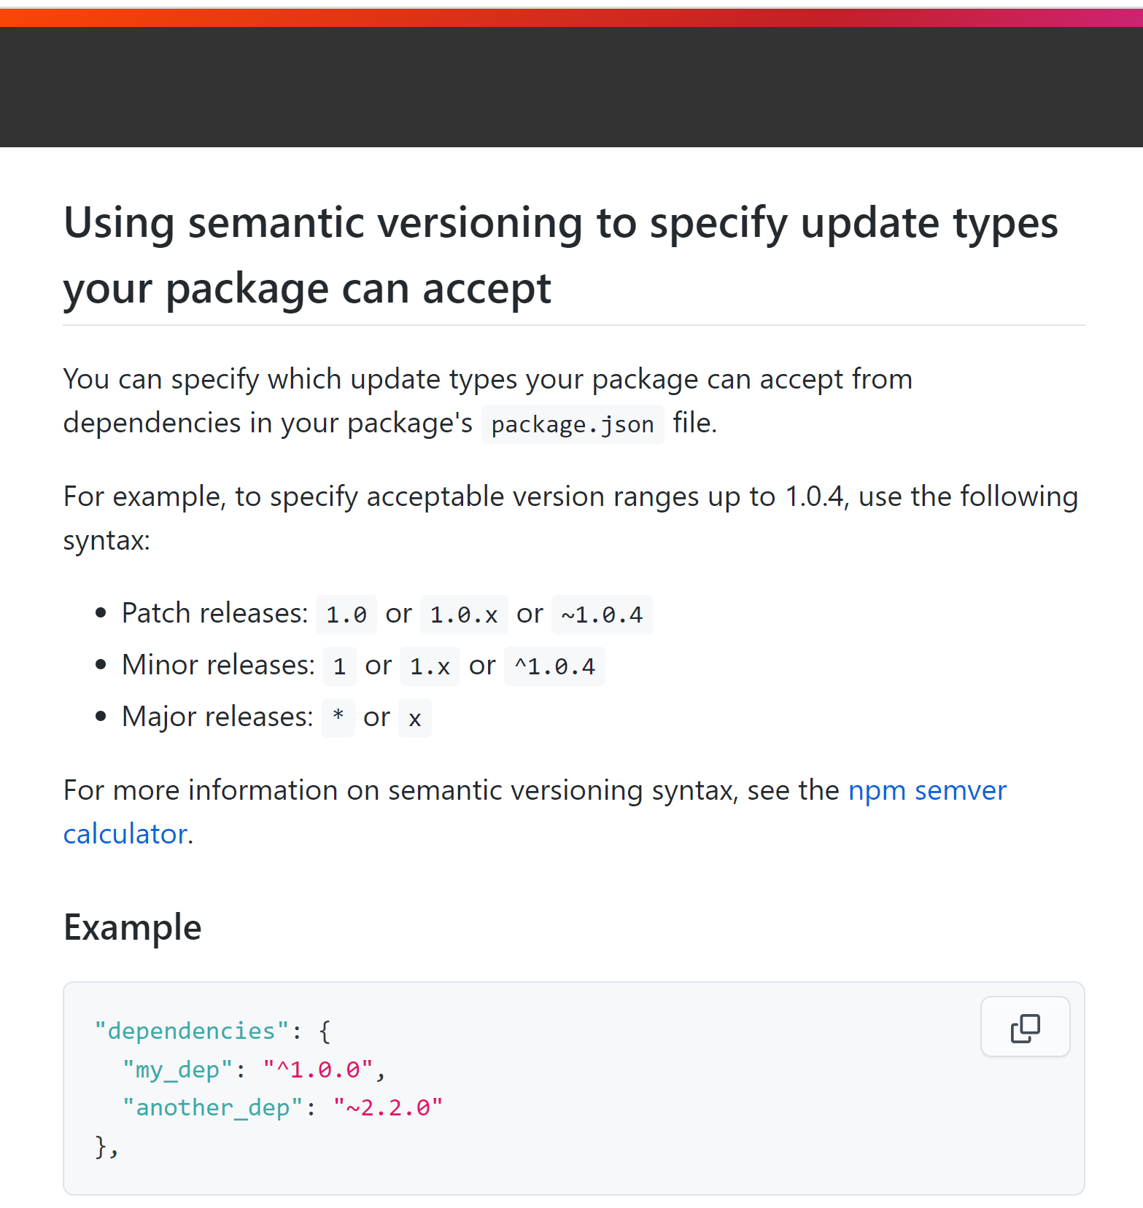
https://docs.npmjs.com/about-semantic-versioning

Slide 35
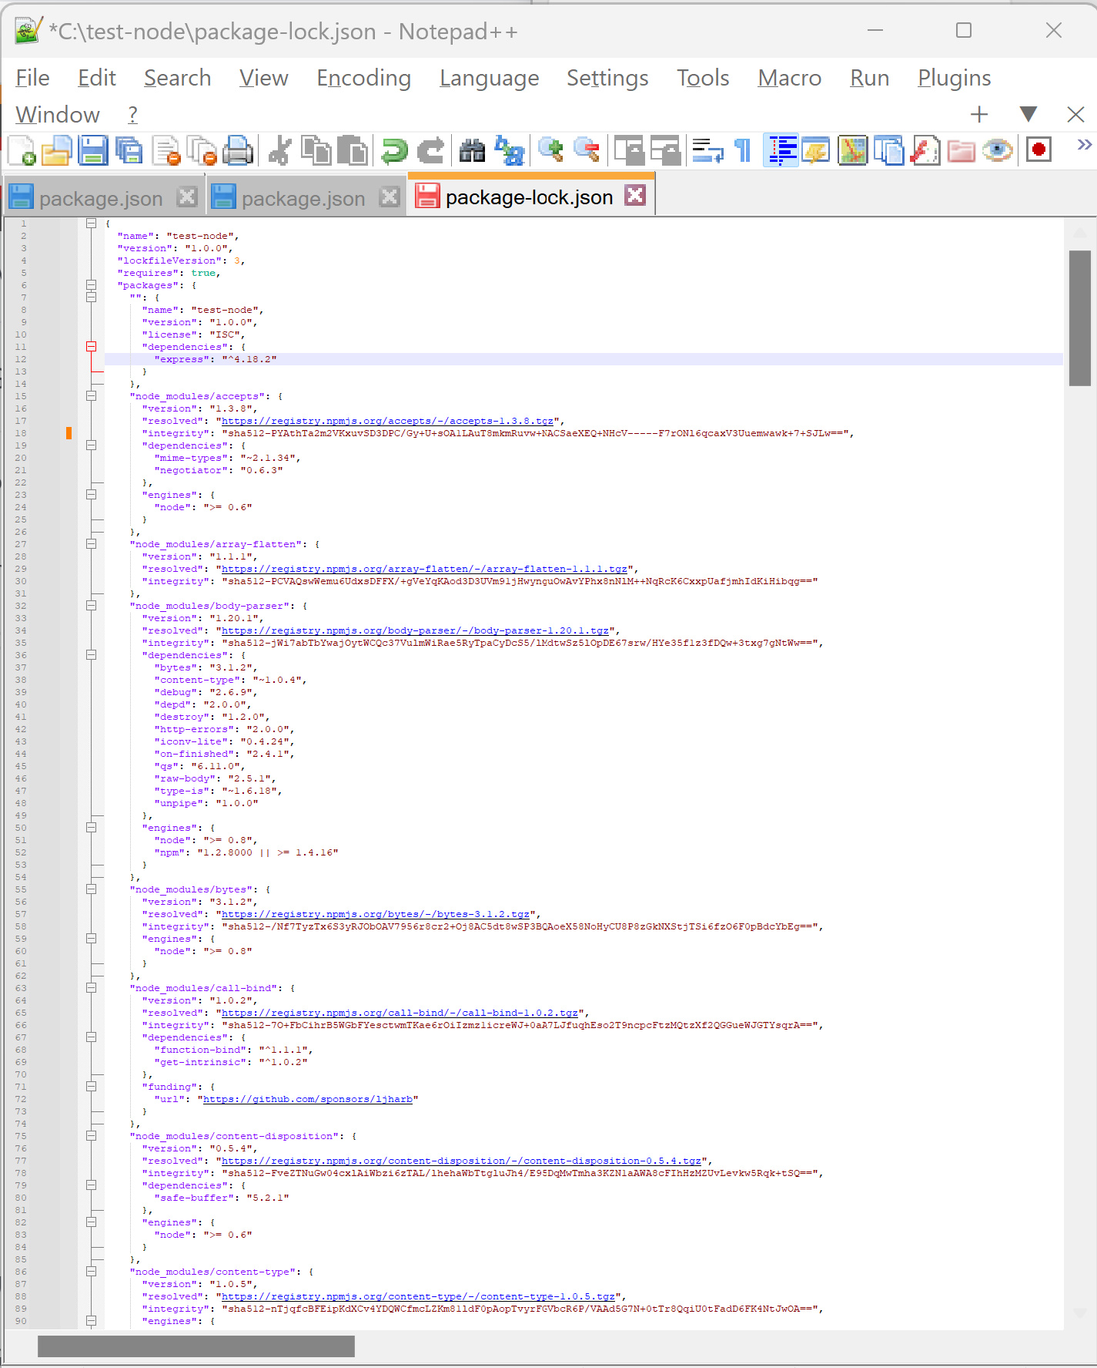
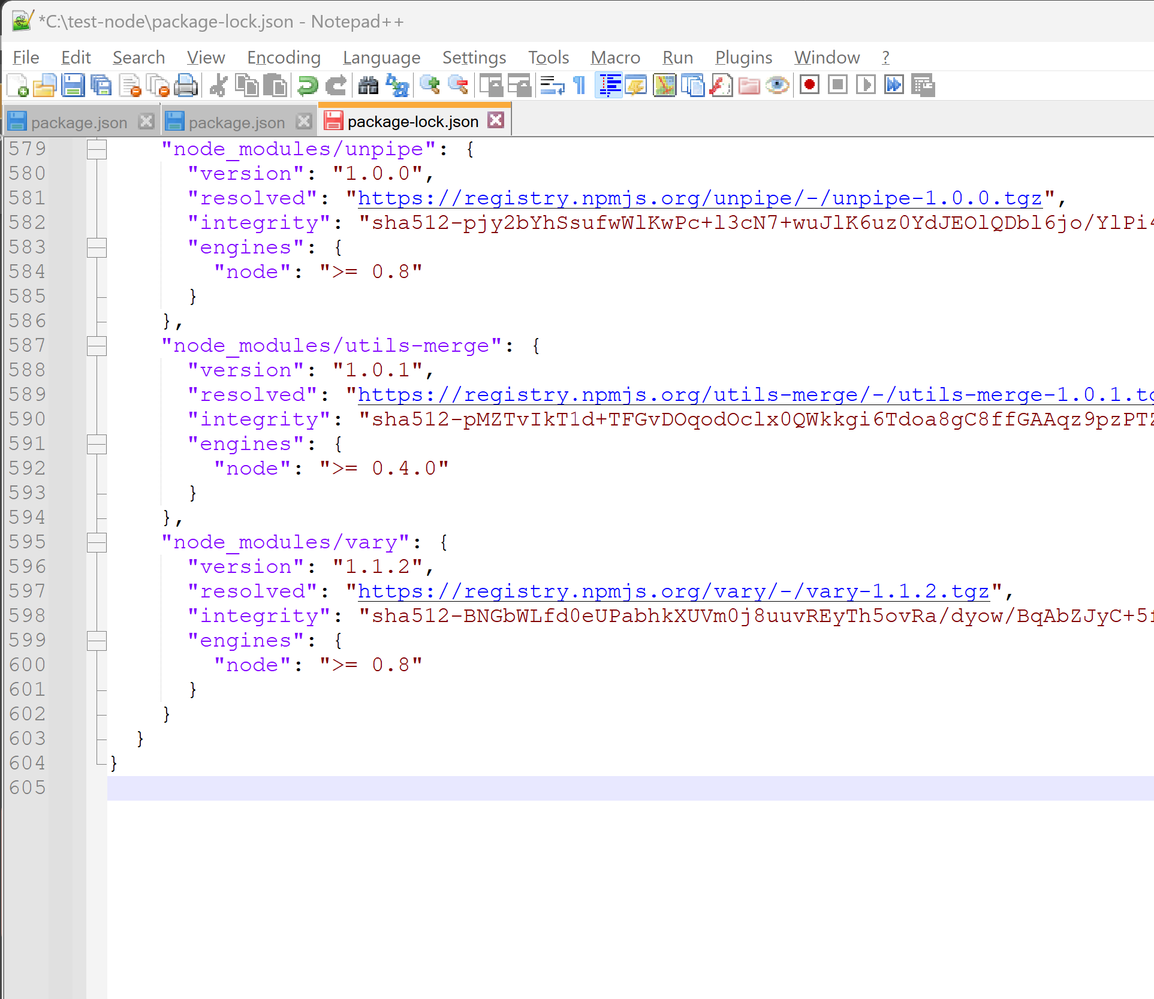
Locking versions number … package-lock.json
File is HUGE …
Like expanded package/package/package !!!
ONLY « express » ➔ 605 lines

Slide 36
node_modules/*/*/*/*.js
Directory node_modules 1/ may be BIG …. ~300 Mega is frequent with few dependencies
$ du -sh node_modules
2/ can be deleted + re-downloaded safely
$ rm –rf node_modules; npm install
3/ should NEVER be committed to any git repository
$ echo node_modules/ >> .gitignore

Slide 37
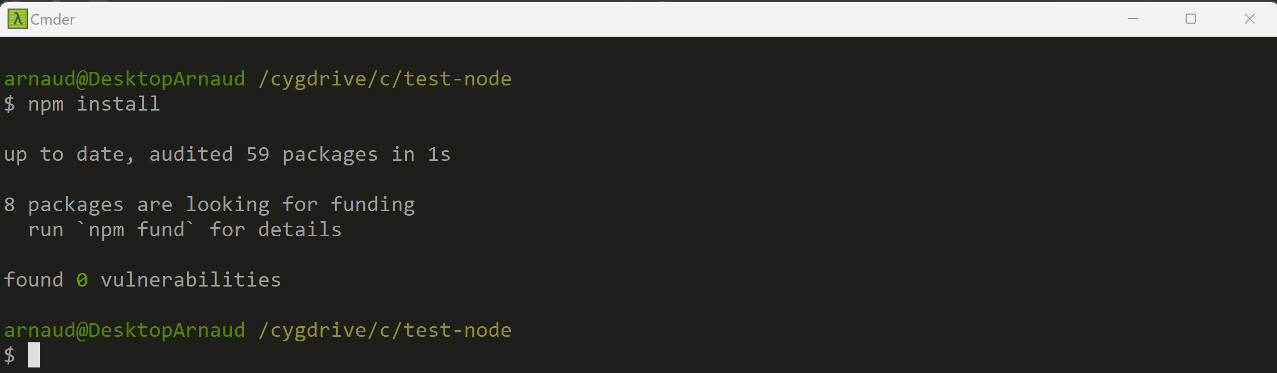
After getting some web project source code… => downloads to re-fill node_modules/** as defined in package.json $ npm install

Slide 38
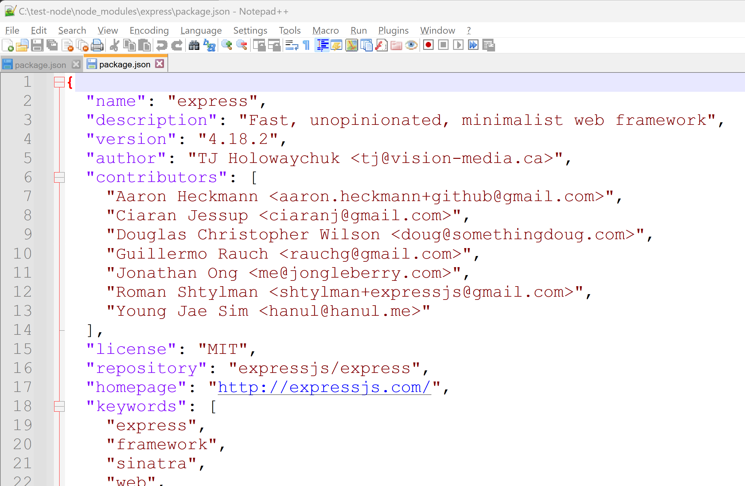
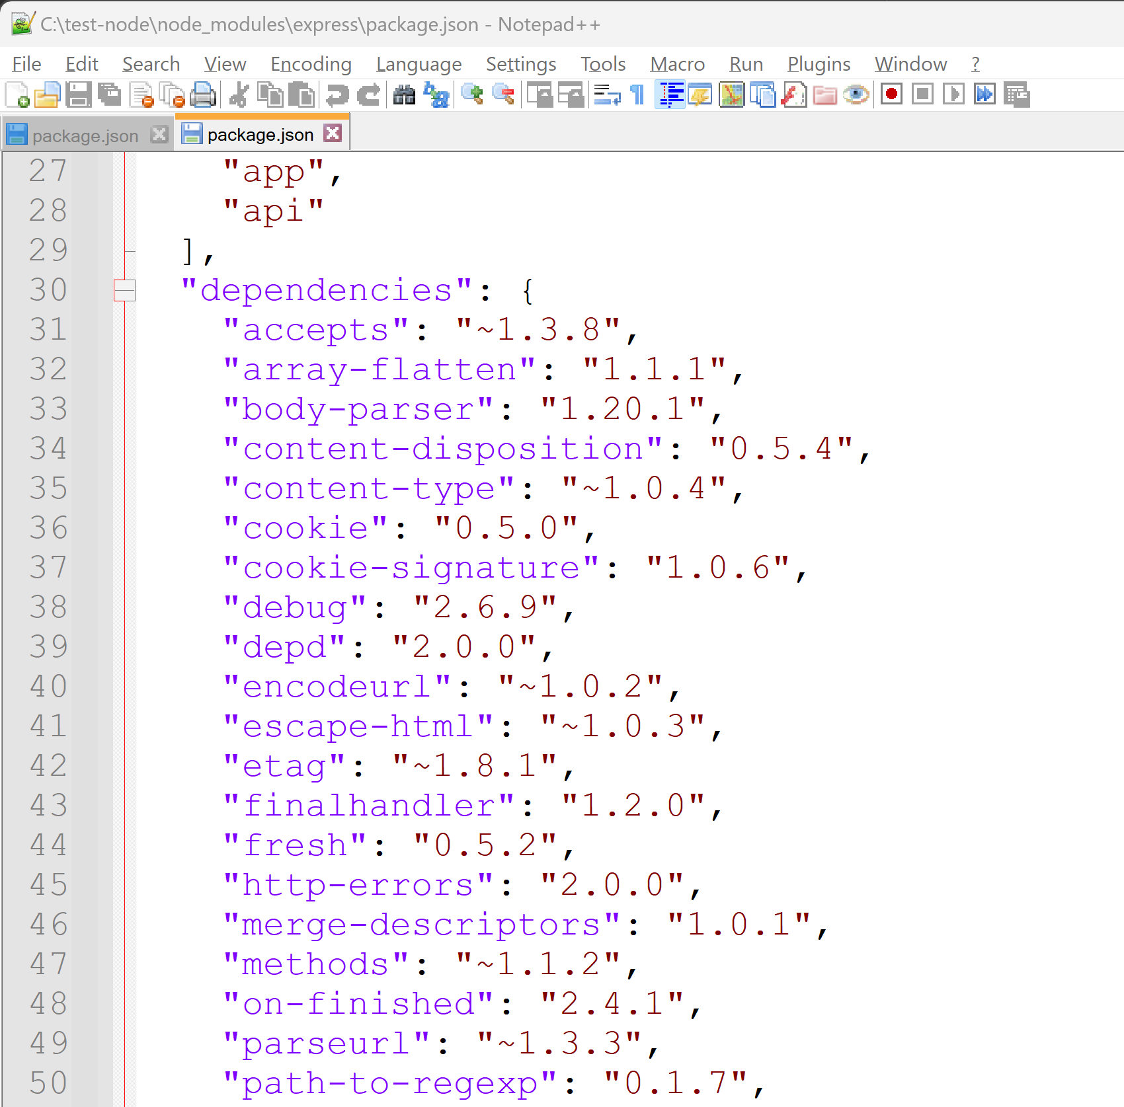
node_modules/express/package.json

Slide 39
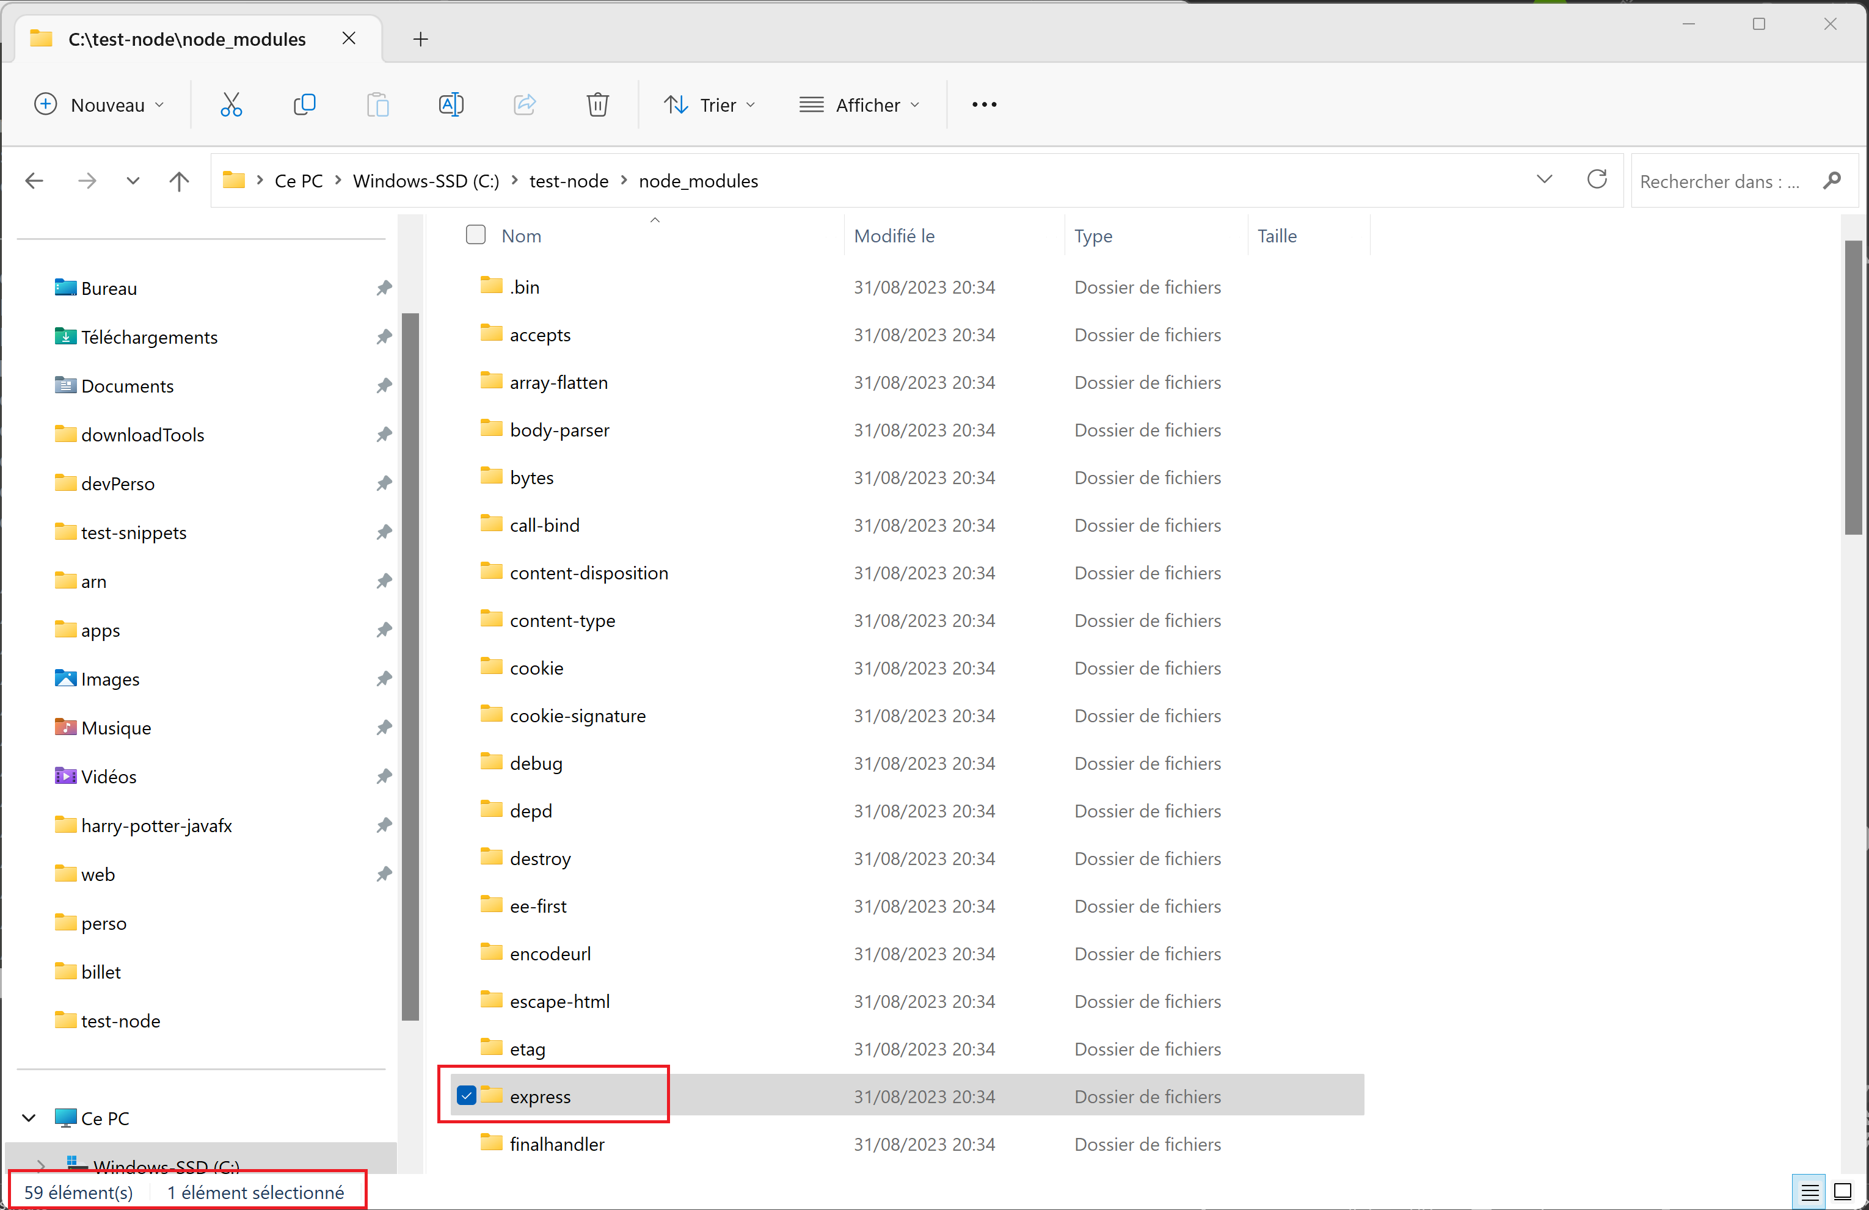
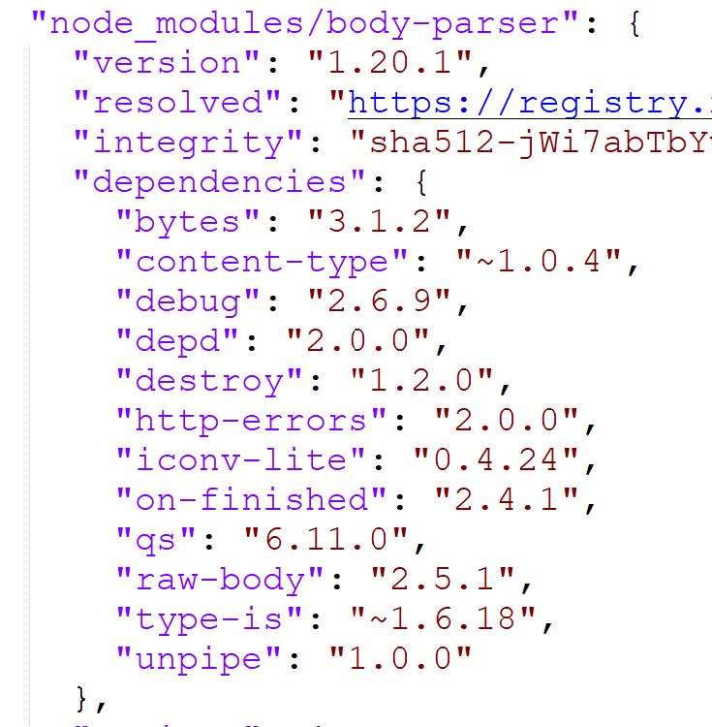
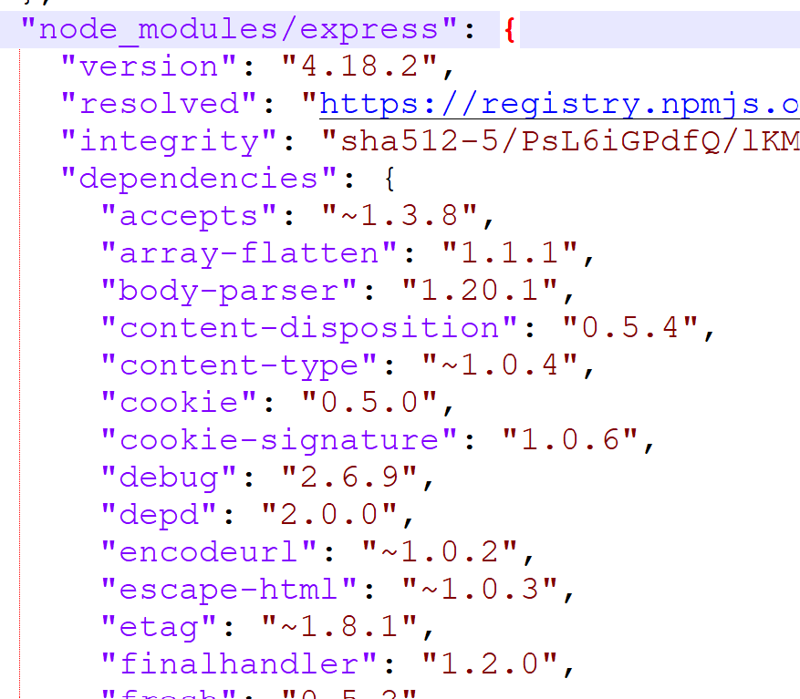
package.json -> package.json -> … package.json transitive dependencies

Slide 40
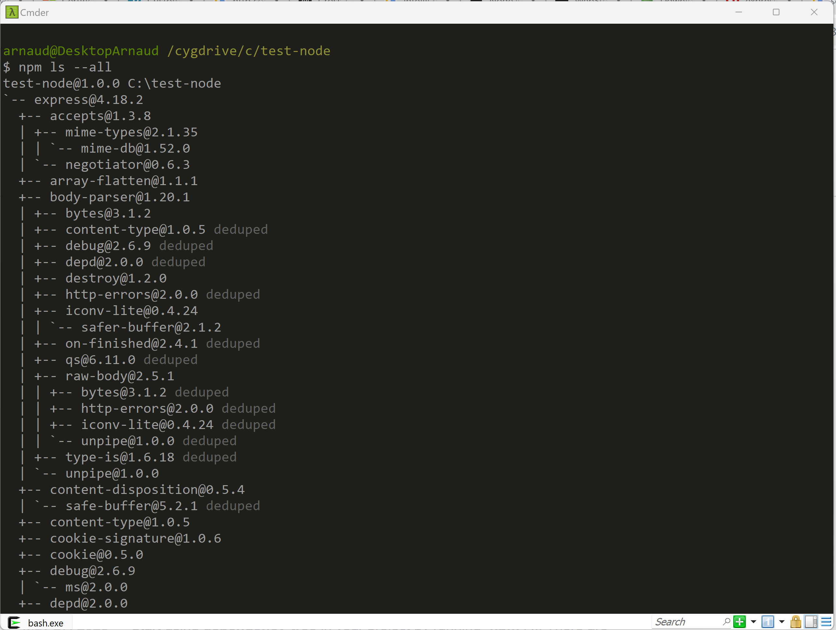
npm ls --all

Slide 41
Coffee break (?)

Slide 42
Choose a Text Editor
IntelliJ Ultimate
Notepad++
WebStorm
SublimeText
Vi
Notepad
VisualStudio Code
Wordpad
Eclipse
NetBeans

Slide 43
Choose (NOT a Text Editor) a modern IDE
IntelliJ Ultimate
€€€$$$ (or 30 days)
WebStorm
€€$$ (or 30 days)
VisualStudio Code
Eclipse + plugins
Eclipse(plugins not pre-installed)
IntelliJ (No web js Support)

Slide 44
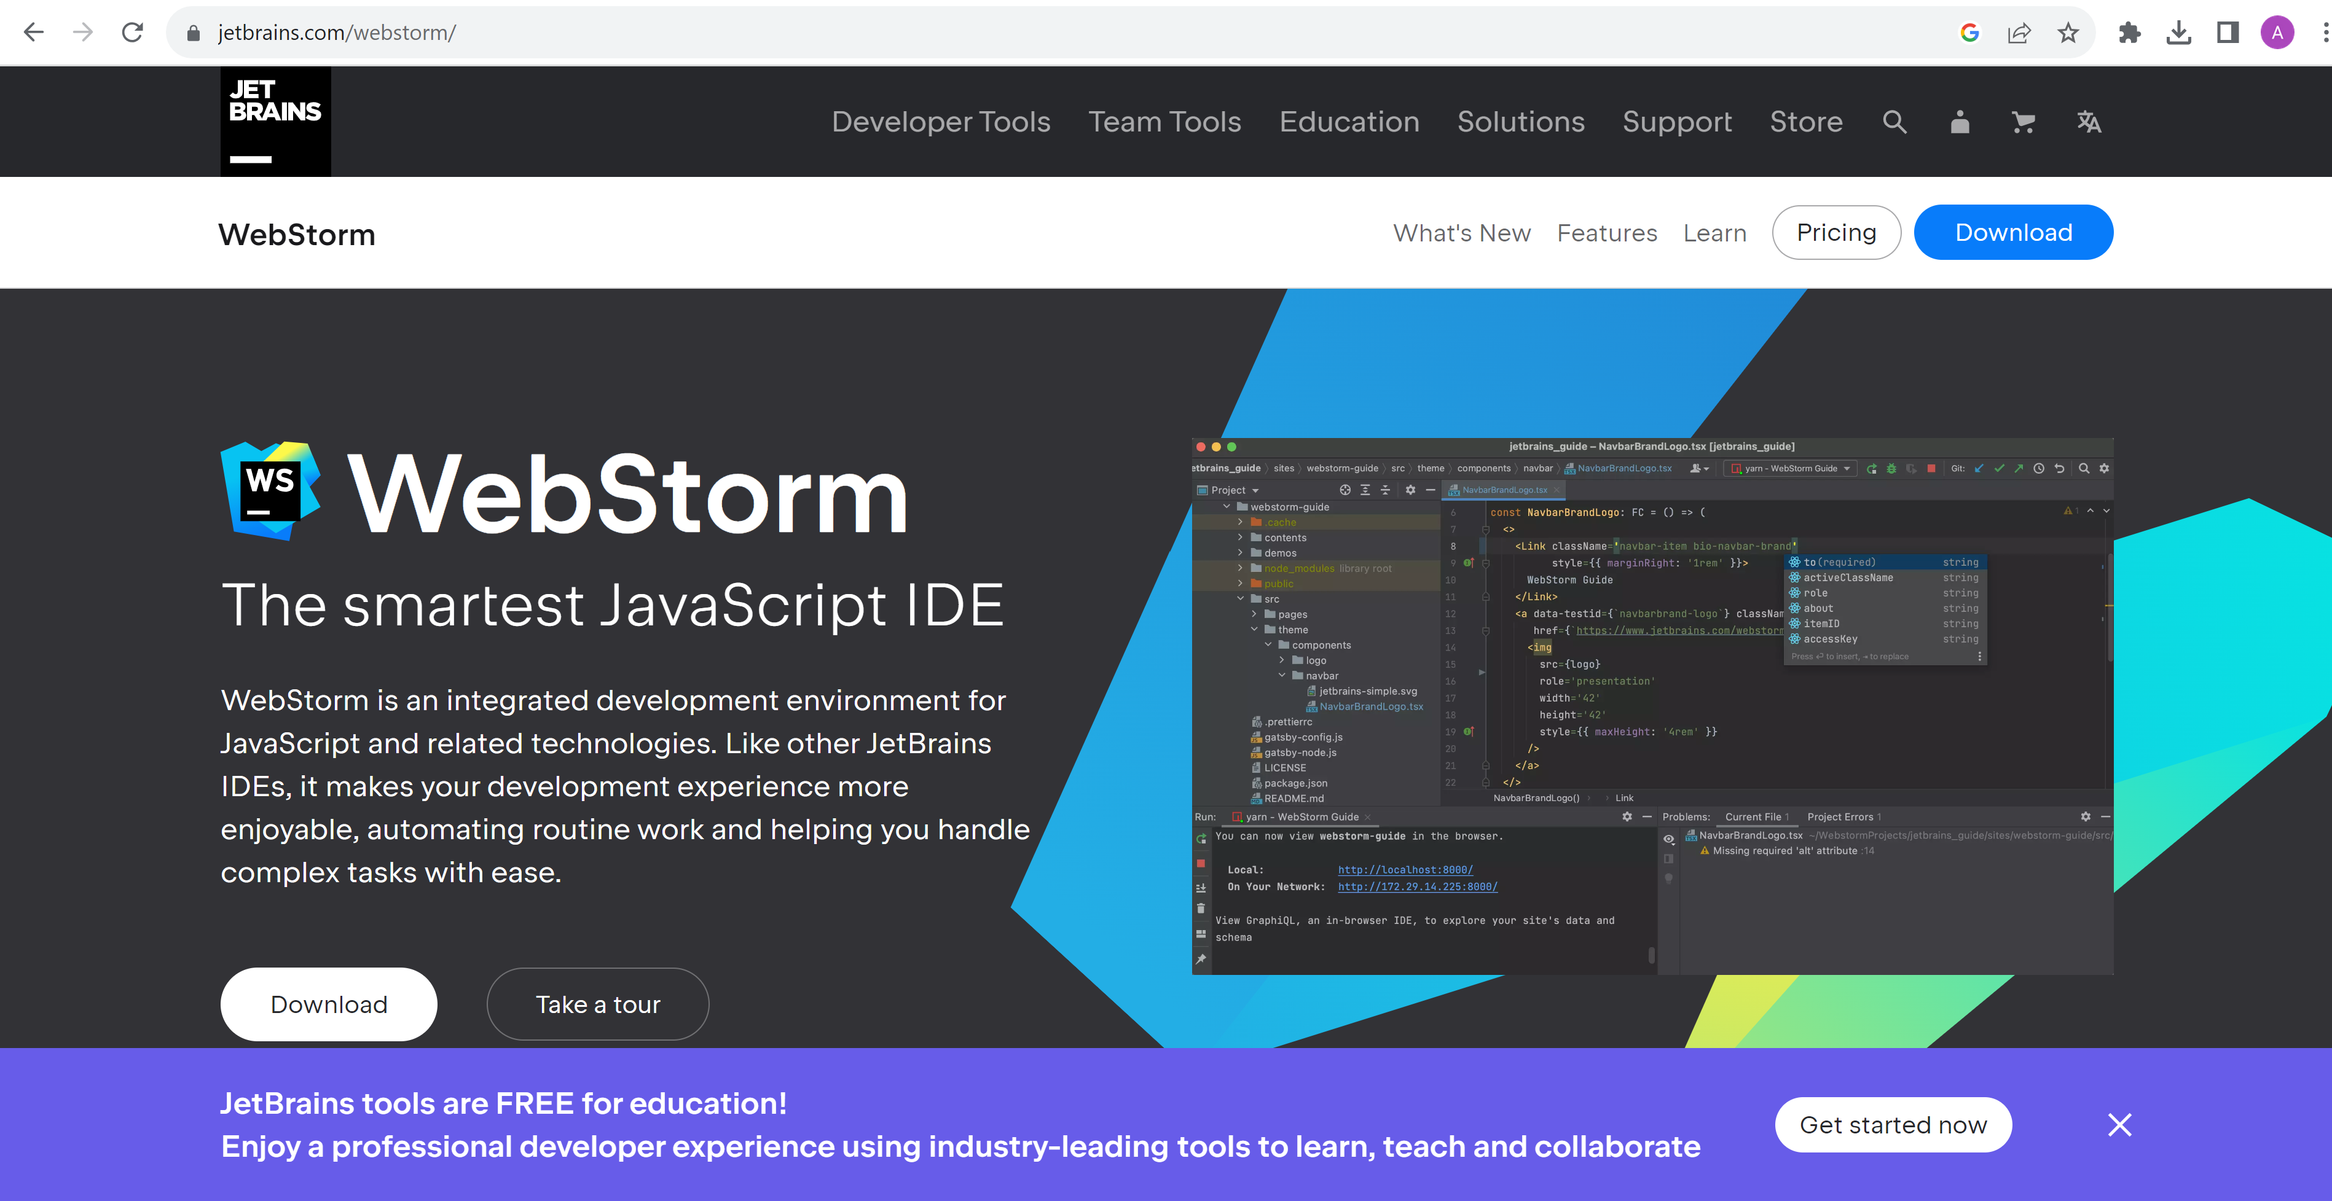
https://www.jetbrains.com/webstorm/

Slide 45
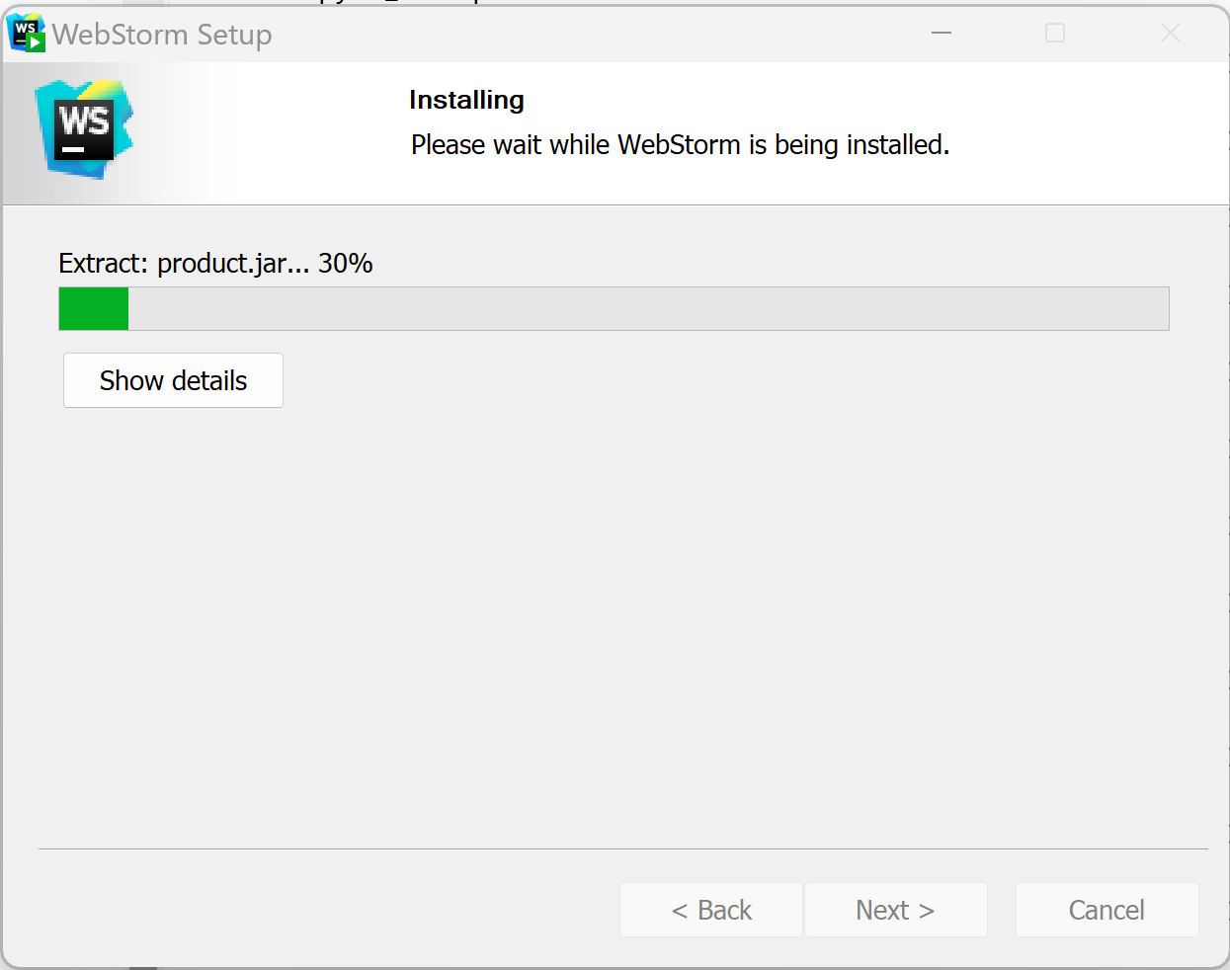
Download 30 days free evaluation + Install …

Slide 46
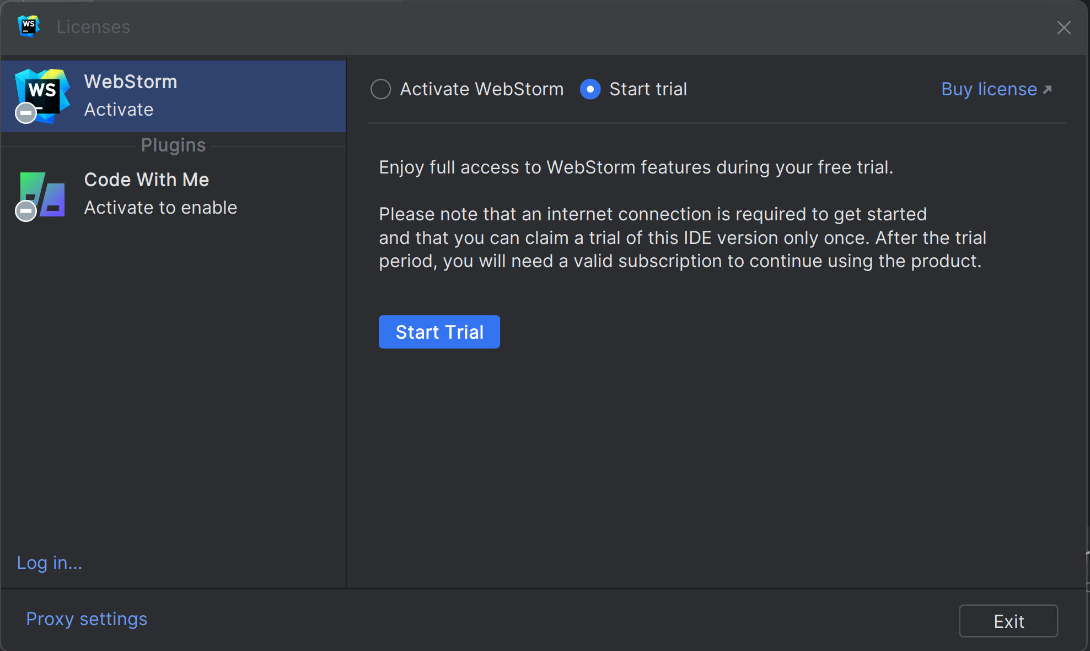
Notice Licenses: IntelliJ Ultimate = WebStorm + IntelliJ + …. IntelliJ Community = .. NO web !

Slide 47
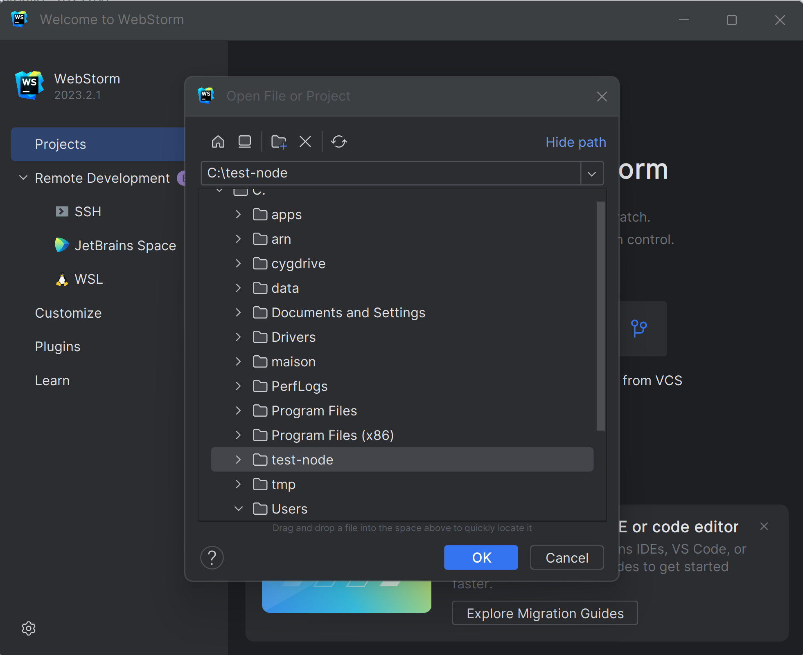
Open Project

Slide 48
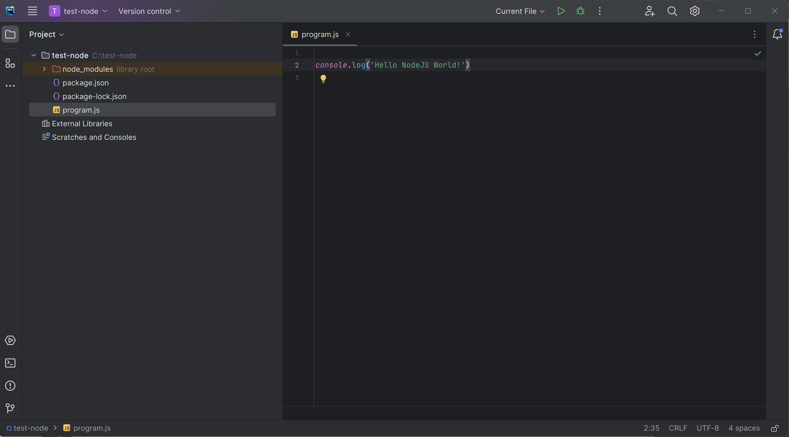
Edit program.js File

Slide 49
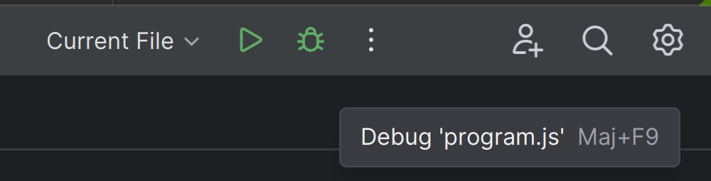
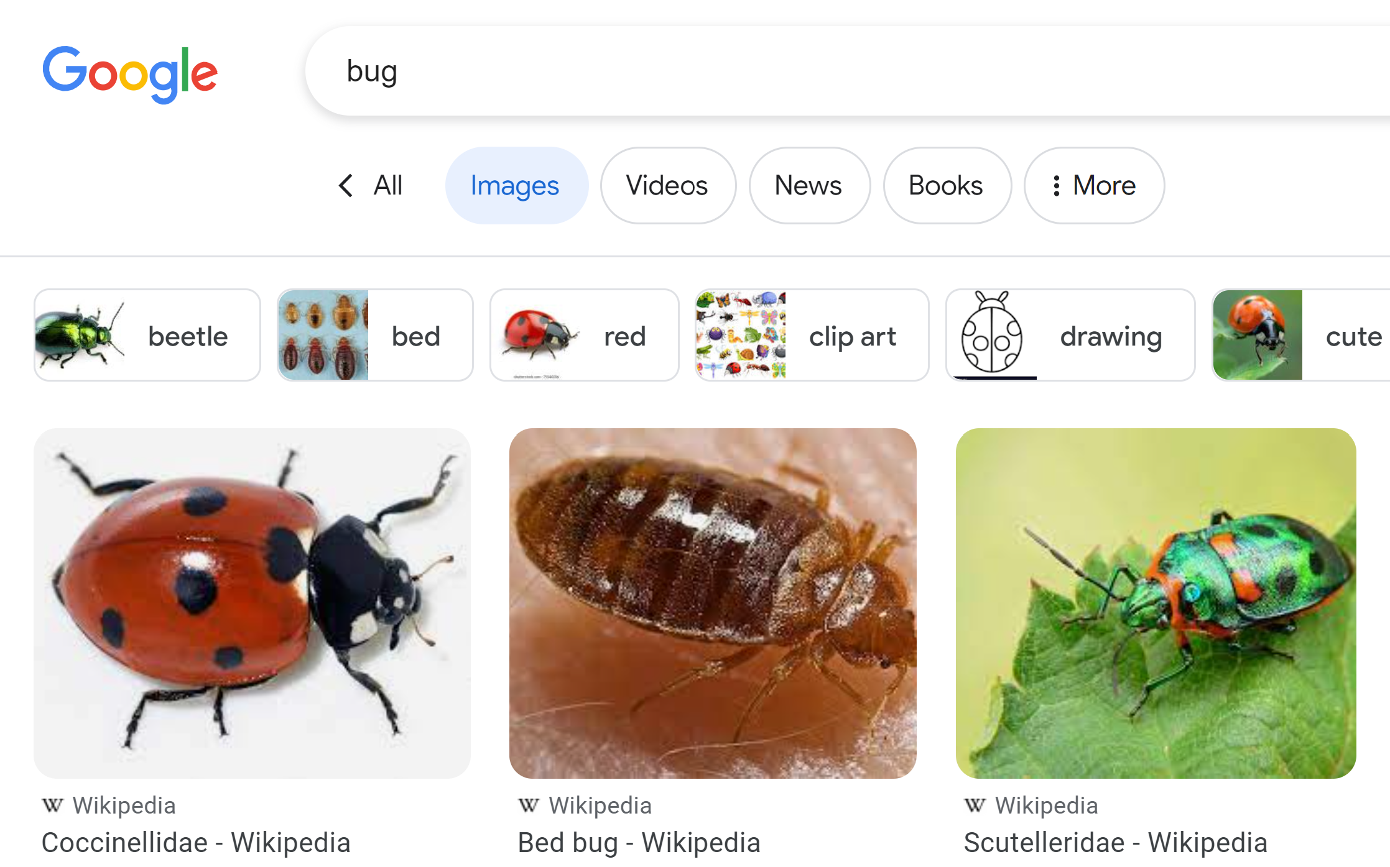
Click on « Run » or « Debug » ?
Debug Mode …. Find the « bug »
Can put breakpoints !
Run Mode ….
Start and forget
Can NOT activate any breakpoint
… can only see logs, and Kill
Why do you use an IDE Debugger
Use directly « C:> node » ??

Slide 50
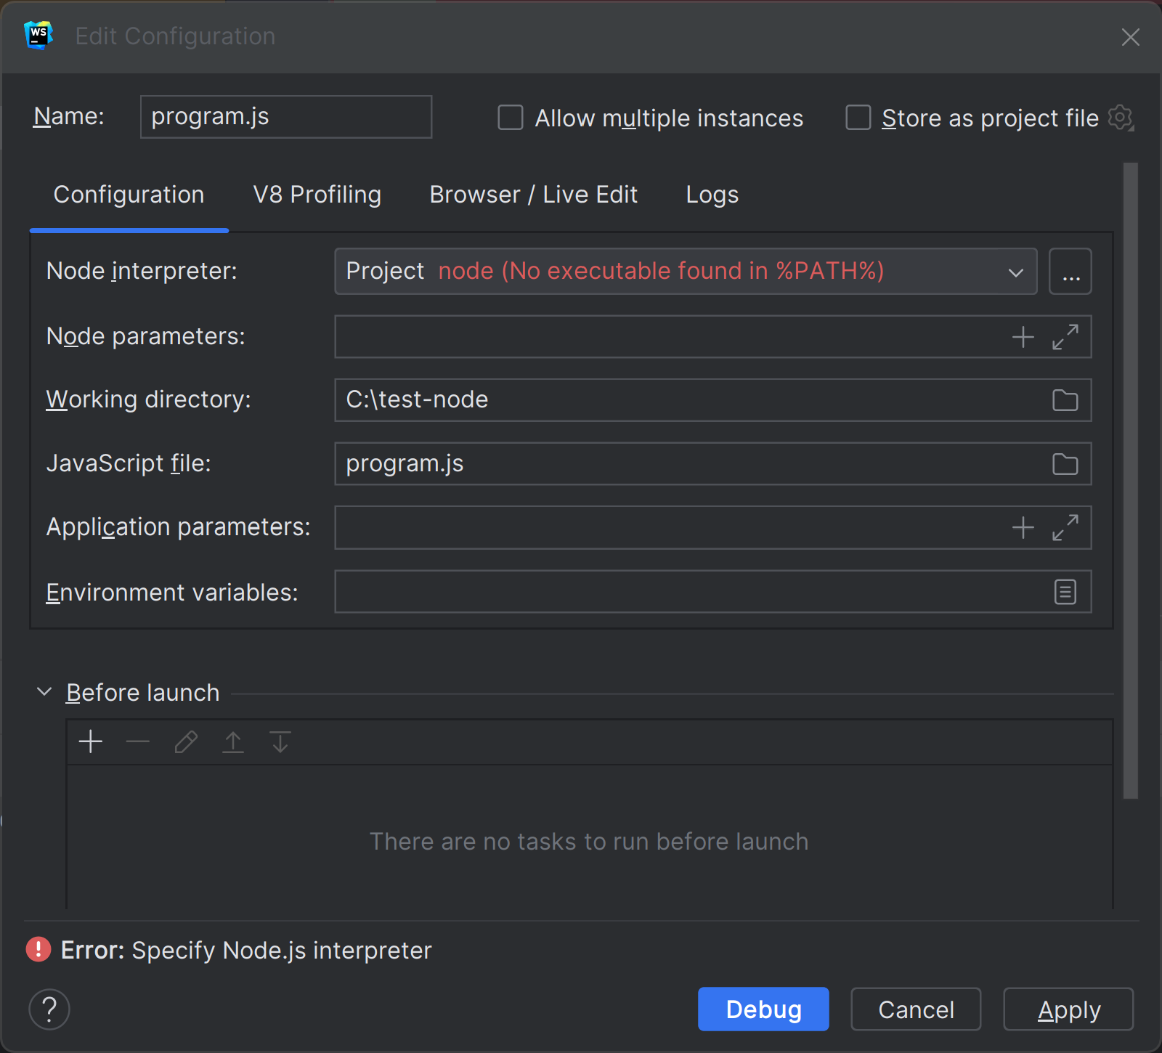
… Case undetected « node » not in %PATH%
System Diagnostic

Slide 51
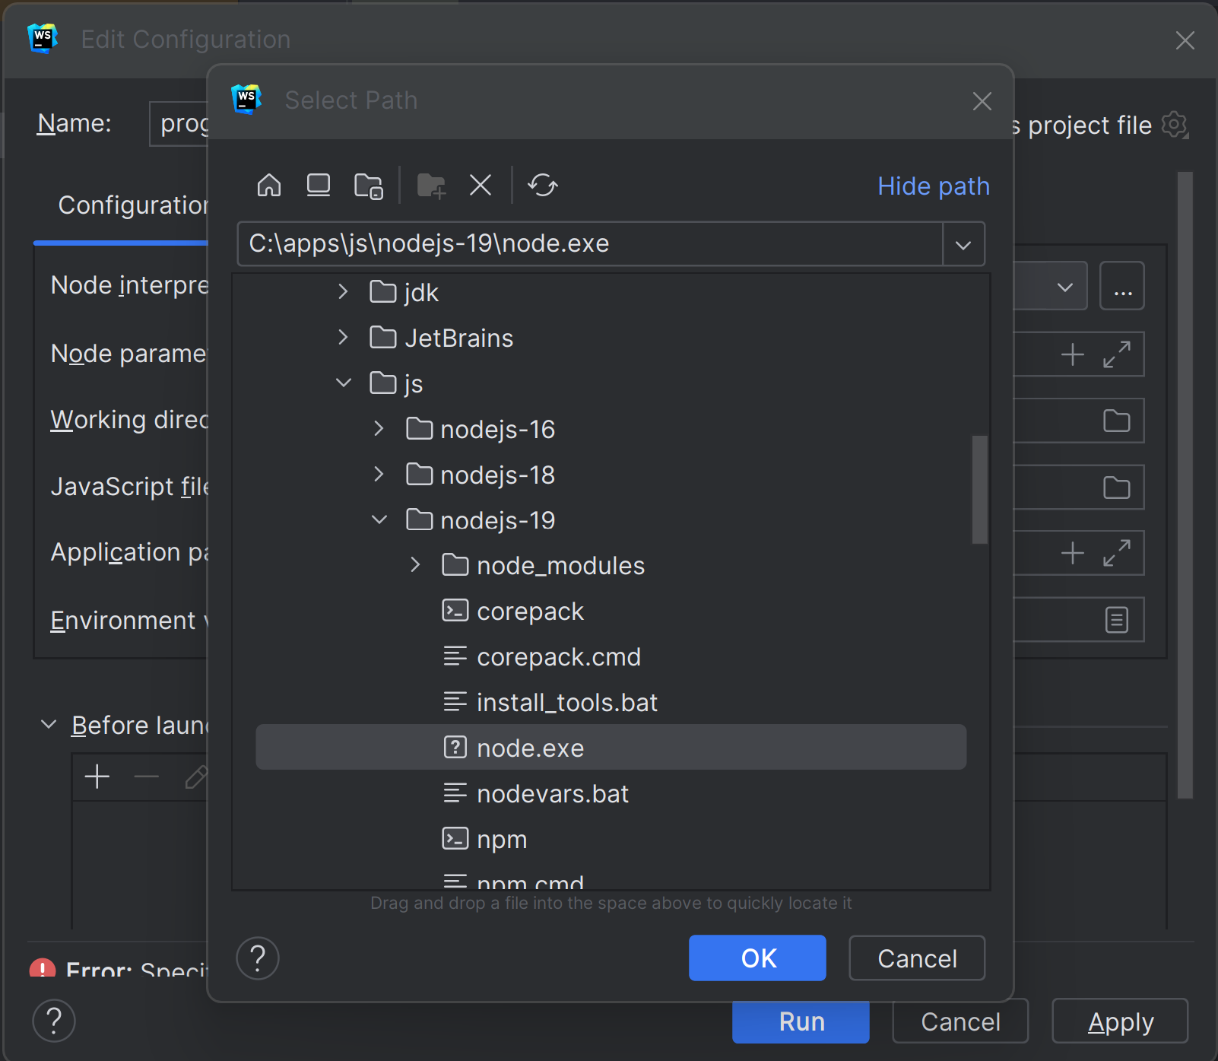
Configure … Add node
System Diagnostic

Slide 52
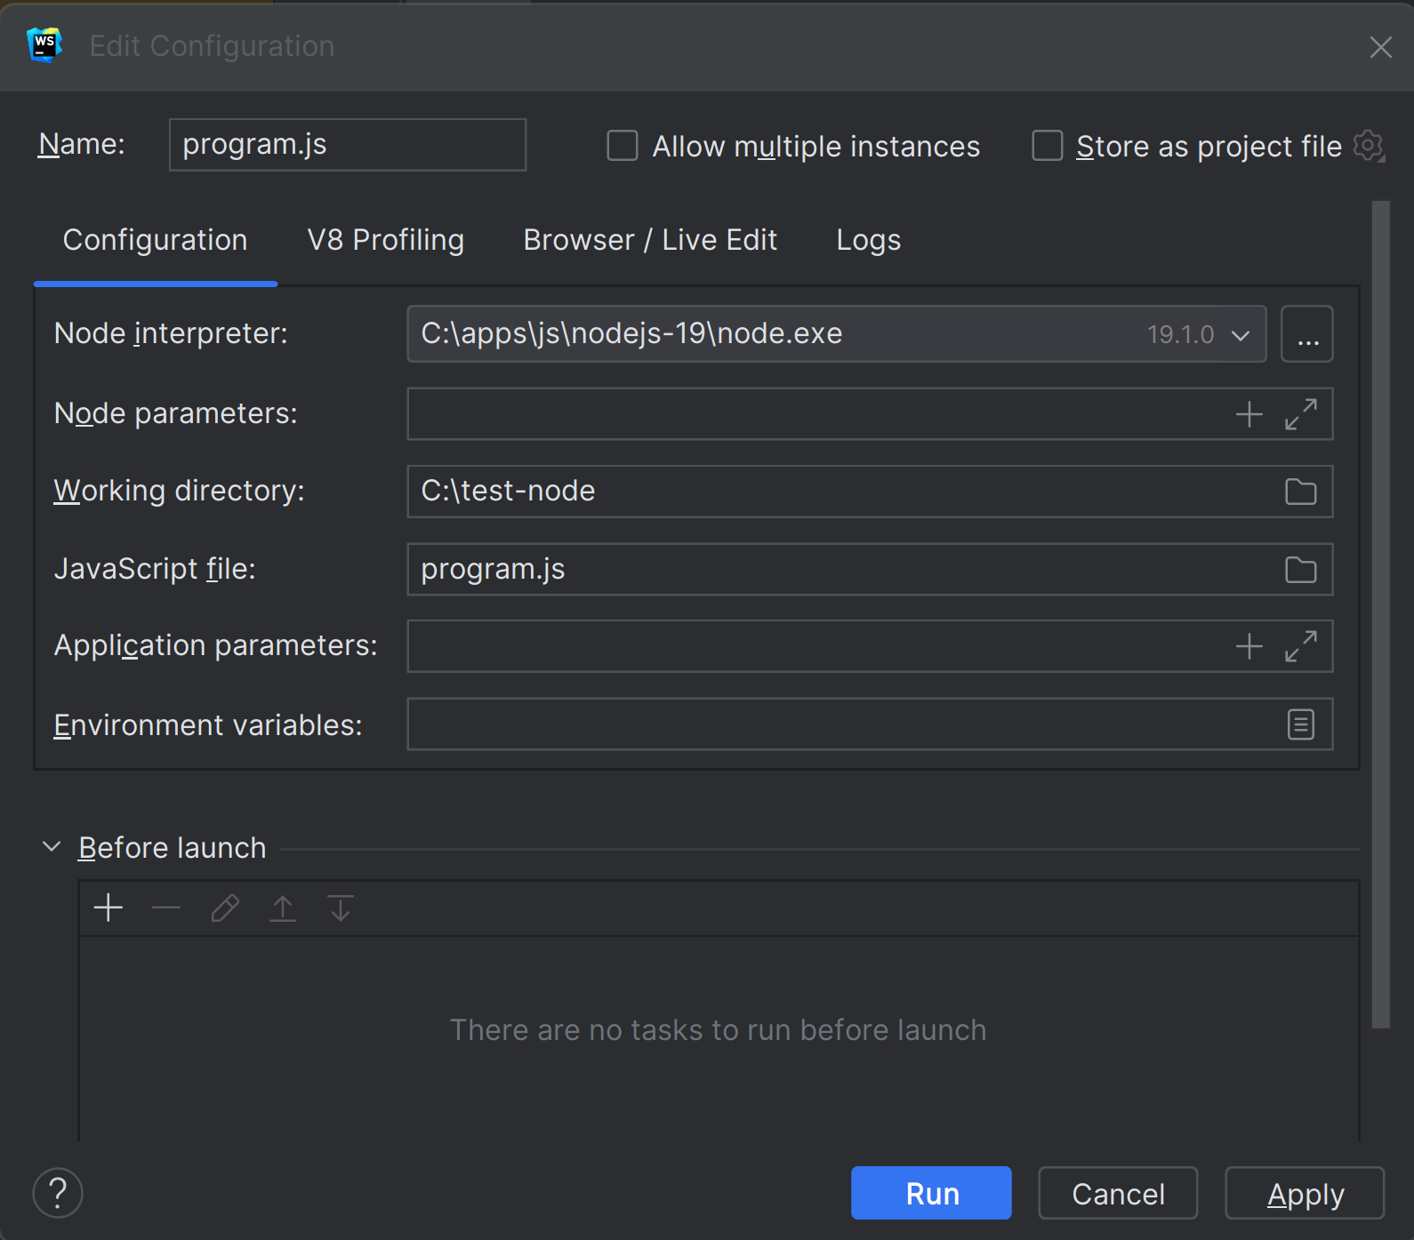
Edit Run/Debug configuration…
System Diagnostic

Slide 53
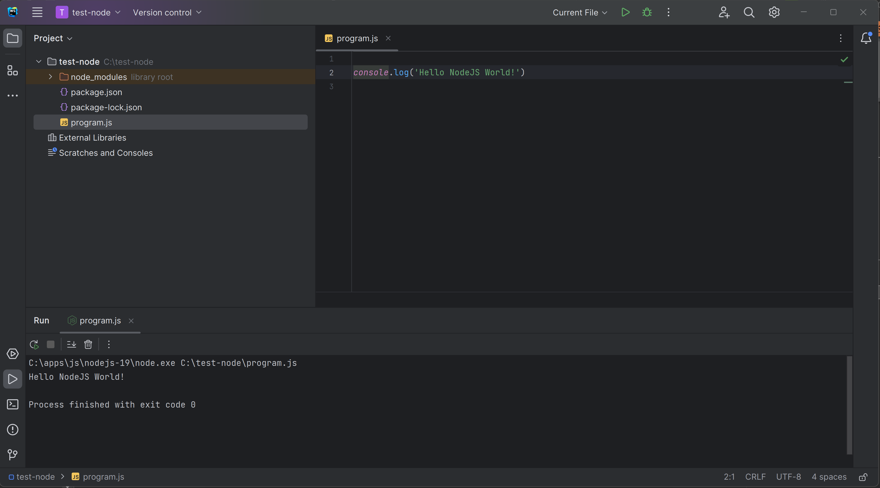
« Run » … Program Finished + console print

Slide 54


Redo « Run » or « Debug » Need to re-edit node in %PATH% ???
System Diagnostic
At least, can re-select
already added choice « C:\... » !

Slide 55


Change configuration « your-config » instead of « Current File »
System Diagnostic

Slide 56

Debug « Mode » + Breakpoint => Program Paused

Slide 57

Step Into(F7) < Step Over(F8) < Step Out (Maj F8) < Resume (F9)

Slide 58
Coffee Break

Slide 59

Complains on JavaScript ?
for Christmas Wish List, ask
Types declarations (standard types, structural types, union types)
Compiled-time Type checking
With Implicit types inference
Object-Oriented Classes
Templates
Spread operators
Syntacic sugars
..

Slide 60




TypeScript

Slide 61

Edit a TypeScript *.ts File

Slide 62

Right Click « Compile TypeScript »

Slide 63

Open Item « .ts » > Sub Item « .js » see generated Js !!

Slide 64

Debug Ts program … (No Run/Debug/breakpoint in *.ts, but ok in *.js) need « .map » file for mapping ts line X <-> js line Y

Slide 65

Edit Settings > TypeScript > Recompile on changes

Slide 66

Edit on Left *.ts … see real time change in right *.js

Slide 67



Edit many **/*.ts … see corresponding **/*.js
Expand views
Check on FileSystem

Slide 68
tsc = TypeScript Compiler … same as in IDE, but in batch mode, for CI-CD
tsc is internally used by WebStorm
… / IntelliJ / VisualStudio Code / Eclipse !!
tsc even generalised it as « langage server »
=> You have exact same compilation in all IDEs !!

Slide 69

https://www.typescriptlang.org/docs/handbook/typescript-tooling-in-5-minutes.html

Slide 70

$ npm install –g typescript ( « -g » for « --global » … add tsc in node %PATH%)

Slide 71

$ tsc

Slide 72
3 uses cases … 1/ compile 1 single .ts file 2/ compile **/*.ts in project 3/ « -w » real-time watch to recompile on change

Slide 73

$ tsc single-file.ts

Slide 74

Tsc Compiles … find ERRORs messages at compile-time Compare… remember typo found at runtime ? https://my-broken-web-site-deployed-in-PROD.html

Slide 75

Create tsc configuration file: « tsconfig.json »

Slide 76

Default tsconfig.json

Slide 77

Notice sourceMap:true in tsconfig.json … and **/*.js.map files generated

Slide 78

.map file … = « lineNumber » debugging info between source « *.ts » and generated « *.js » Analogy with java: between source « *.java » and generated « *.class »

Slide 79
Remark and Analogy
JavaScript is the « low-level » assembler langage (~x64) on the Web
Supported by all « web browsers » AND « node » (~intel/amd processors)
No developper code anymore in assembly langage directly
(they prefer high-level C, C++, Java, C#, Python, …)
Web developper prefers TypeScript rather than Js directly ..

Slide 80
Remark of The Remark … WebAssembly
JavaScript is such an horrible monster langage
(with eval and strange permissive things)
W3c standard « WebAssembly » use only a SUBSET of JS
… that can be really statically typed / analysed / understood
then transformed to native x64 code by « compiler »
« WebAssembly » is trully a fast assembly langage
almost as fast as optimised « normal » code

Slide 81

.map Goodies … can put breakpoint on *.ts (still debugging *.js for launch)

Slide 82

$ tsc ( or equivalent : $ tsc –p tsconfig.json )
Case when error…
Case when OK…
NO log !!

Slide 83

$ tsc -w
Case when OK…
NO log
Case when error… cf next slide

Slide 84


Edit file to get Compile Error with –w (watch)

Slide 85

Install « typescript » in package.json devDependencies (devDependencies != dependencies, != global ) $ npm install –save-dev typescript

Slide 86

devDependencies…

Slide 87


Edit package.json « scripts »
« $ npm run compile-typescript »
… is equivalent to « $ tsc »
« $ npm run build »
… is equivalent to « $ tsc -w »
Notice:
There are Run icons for each script line

Slide 88
Understanding Angular « ng » client internals
« npm run start»
Internally Call
Internally Call
« ng serve »
« tsc -w»
Compile all *.ts to *.js
(maybe webpack all into a single app.js )
Internall call « node » with express server
… http server running on port « http://localhost:4200 »
All commands « npm », « ng », « tsc »
Run internally « node » !!!
Also Use « live-reload.js » …
so Web browser automatically refresh page on change

Slide 89
Coffe Break (?)

Slide 90

Introducing difficulties with Async Code: Callbacks, Promises, async/await, … Threads in a mono-threaded-user NodeJs model
A simple http GET fetch()
.. The Hello world on http !

Slide 91
Noticed WebStorm automatically show « :type » and parameter « name: » in grey

Slide 92

Adding console.log(…)

Slide 93

In which order are the console.log()s printed? 1, 2, 3, 4 ? … other? which order?

Slide 94

Response: 1, 4, 2, 3 !!

Slide 95

Put Breakpoint and Debug

Slide 96

Can you spot the bug here ?

Slide 97
Spot the Bug … 4 Clues
1/ No Compile ERROR … but Running => see in console logs
2/ Executing in Debug mode => check variables values
3/ WebStorm underline « .text() » as a possible warning
4/ Can you Spot the inconsistent Type infered by WebStorm
(not a bug in WebStorm)

Slide 98

Clue 1/ Run, see in console log Understand the « undefined » instead of <html>… ?

Slide 99

Clue 2 / Debug with Breakpoint … indeed « body » is undefined

Slide 100


Clue 3/ .text() in underlined in WebStorm ?

Slide 101

Check « .text() » : Browsing code -> definition !

Slide 102

Clue 4/ Inconsistent types … was expecting « string », got « void »

Slide 103
Promise and nested Callbacks => Cascading Hell async/await Solution Cf also RxJS (out of scope here… But used in Angular)

Slide 104

Transforming fetch().then() … to await fetch()

Slide 105

Run async/await …

Slide 106
Coffe Break / Lunch Break (?)

Slide 107
Next Steps…

